Slide 1


Modern Operating Systems
Fifth Edition
Chapter 2
Processes and Threads
Copyright © 2023, 2014, 2008 Pearson Education, Inc. All Rights Reserved
Notes:
If this PowerPoint presentation contains mathematical equations, you may need to check that your computer has the following installed:
1) MathType Plugin
2) Math Player (free versions available)
3) NVDA Reader (free versions available)

Slide 2
Processes and threads
Introduction to Processes
The Process Model
Process Management
Process States
Threads
Signal Handling
Inter-Process Communication
I P C Mechanisms
Classical I P C Problems
Scheduling

Slide 3
The Process Model
Process = Program in execution
How many processes for each program?
A fundamental operating system abstraction
Allows the O S to simplify:
Resource allocation
Resource accounting
Resource limiting
O S maintains information on the resources and the internal state of every single process in the system

Slide 4
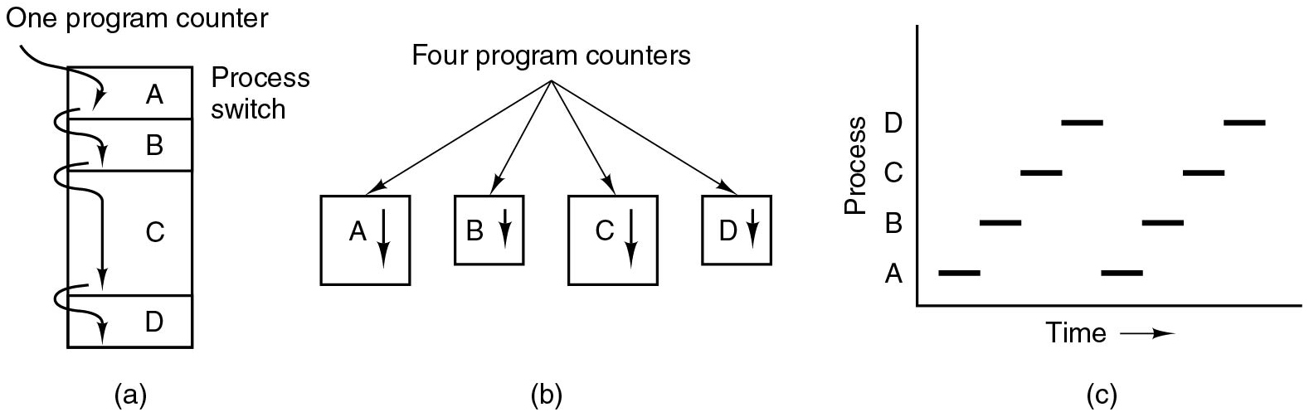
The Process Model (1)
Single program counter
Each process in unique location
C P U switches back and forth from process to process
Figure 2.1 (a) Multiprogramming of four programs.
Notes:
Long description:
Part (a): A vertical rectangular block labeled One program counter has four partitions, out of which the third partition is large. The partitions from top to bottom are labeled A, B, C, and D. Partition A is labeled Process switch. Four downward arrows point to each block individually, starting from one program counter to A, A to B, B to C, and C to D.

Slide 5
The Process Model (2)
Each process has own flow of control (own logical program counter)
Each time we switch processes, we save the program counter of first process and restore the program counter of the second
Figure 2.1 (b) Conceptual model of four independent, sequential processes.
Notes:
Long Description:
Part (b): Four vertical rectangular blocks have arrows starting from a point labeled Four program counters. The four blocks are labeled A, B, C, and D and all blocks are marked with downward arrows.

Slide 6
The Process Model (3)
All processes make progress, but only one is active at any given time
Figure 2.1 (c) Only one program is active at once.
Notes:
Long Description:
Part (c): Graph: The horizontal axis is labeled Time. The vertical axis is labeled Process. The range of processes is A, B, C, and D. Two sets of horizontal bars are marked at every process in the form of low to high step ladder.

Slide 7
Concurrent Processes
In principle, multiple processes are mutually independent
They need explicit means to interact with each other
The C P U can be allocated in turns to different processes
O S normally offers no timing or ordering guarantees
Notes:
Long Description:
Part (a): A vertical rectangular block labeled One program counter has four partitions, out of which the third partition is large. The partitions from top to bottom are labeled A, B, C, and D. Partition A is labeled Process switch. Four downward arrows point to each block individually, starting from one program counter to A, A to B, B to C, and C to D. Part (b): Four vertical rectangular blocks have arrows starting from a point labeled Four program counters. The four blocks are labeled A, B, C, and D and all blocks are marked with downward arrows. Part (c): Graph: The horizontal axis is labeled Time. The vertical axis is labeled Process. The range of processes is A, B, C, and D. Two sets of horizontal bars are marked at every process in the form of low to high step ladder.

Slide 8
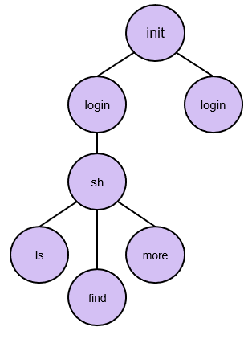
Process Hierarchies
O S typically creates only 1 init process
Subprocesses created independently:
A parent process can create a child process
This results in a tree-like structure and process groups
E.g., shell executes commands:
$ find /tmp &> t.log &
$ ls | more
Notes:
Long Description:
From the top, the constituents are as follows. I N I T, login, s h. S h is further divided into l s, find, and more.

Slide 9
Process Creation
Four principal events that cause processes to be created:
System initialization
Execution of a process creation system call by a running process
A user request to create a new process
Initiation of a batch job

Slide 10
Process Termination
Typical conditions which terminate a process:
Normal exit (voluntary).
Error exit (voluntary).
Fatal error (involuntary).
Killed by another process (involuntary).

Slide 11
Process Management
fork: create a new process
Child is a “private” clone of the parent
Shares some resources with the parent
exec: execute a new process image
Used in combination with fork
exec on Windows?
exit: cause voluntary process termination
Exit status returned to the parent
Involuntary process termination?
kill: send a signal to a process (or group)
Can cause involuntary process termination

Slide 12
Process States (1)
Three states a process may be in:
Running (actually using the C P U at that instant).
Ready (runnable; temporarily stopped to let another process run).
Blocked (unable to run until some external event happens).

Slide 13
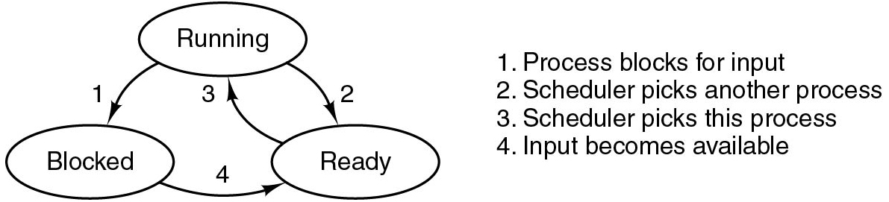
Process States (2)
The O S allocates resources (e.g., C P U) to processes
To allocate the C P U, the O S needs to track process states:
Running: the process is currently executed by the C P U
Blocked: the process is waiting for available resources
Ready: the process is ready to be selected
The scheduler (d e)allocates the C P U (see transitions 2&3)
Figure 2.2 A process can be in running, blocked, or ready state. Transitions between these states are as shown.
Notes:
Long Description:
Transitions between the three states are as shown. There are three oval-shaped blocks labeled Running, Blocked, and Ready. The Running block is placed on top while the other two blocks are placed at the lower left and lower right. There are two downward arrows from running: an arrow labeled 1 points to Blocked and the other arrow labeled 2 points to Ready. An arrow labeled 3 from Ready points to Running block. An arrow labeled 4 from Blocked points to Ready. The description of arrows is mentioned on the right side of the diagram: 1. Process blocks for input. 2. Scheduler picks another process. 3. Scheduler picks this process. 4. Input becomes available.

Slide 14
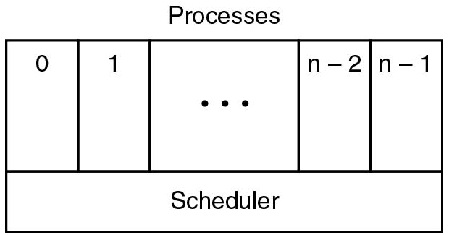
Process States (3)
Scheduler periodically switches processes
Sequential processes lay on the layer above
This leads to a simple process organization
What are the missing fundamental O S abstractions?
Figure 2.3 The lowest layer of a process-structured operating system handles interrupts and scheduling. Above that layer are sequential processes.
Notes:
Long Description:
There is a rectangular block labeled Processes with five vertical partitions and one horizontal partition. The first vertical partition is labeled 0, the second is labeled 1, the third is labeled so on depicted by three dots, the fourth is labeled n minus 2 and the fifth is labeled n minus 1. The horizontal partition is labeled Scheduler.

Slide 15
Information Associated with a Process
I D (P I D), User (U I D), Group (G I D)
Memory address space
Hardware registers (e.g., program counter)
Open files
Signals
This information is stored in the operating system’s Process Table

Slide 16
Process Control Blocks
Process management | Memory management | File management
Registers Program counter Program status word Stack pointer Process state Priority Scheduling parameters Process I D Parent process Process group Signals Time when process started C P U time used Children’s C P U time Time of next alarm | Pointer to text segment info Pointer to data segment info Pointer to stack segment info | Root directory Working directory File descriptors User I D Group I D
Figure 2.4 Some of the fields of a typical process-table entry

Slide 17
Interrupts
Idea: to deallocate the C P U in favor of the scheduler, we rely on hardware-provided interrupt handling support
Allows the scheduler to periodically get control, i.e., whenever the hardware generates an interrupt
Interrupt vector:
Associated with each I/O device and interrupt line
Part of the interrupt descriptor table (I D T)
Contains the start address of an O S-provided internal procedure (interrupt handler)
The interrupt handler continues the execution
Interrupt types: sw, hw device (async), exceptions

Slide 18
Implementation of Processes (2 of 2)
Skeleton of what the lowest level of the operating system does when an interrupt occurs.
Hardware stacks program counter, etc.
Hardware loads new program counter from interrupt vector.
Assembly language procedure saves registers.
Assembly language procedure sets up new stack.
C interrupt service runs (typically reads and buffers input).
Scheduler decides which process is to run next.
C procedure returns to the assembly code.
Assembly language procedure starts up new current process.
Every time an interrupt occurs, the scheduler gets control
acts as a mediator
A process cannot give the C P U to another process (context switch) without going through the scheduler

Slide 19
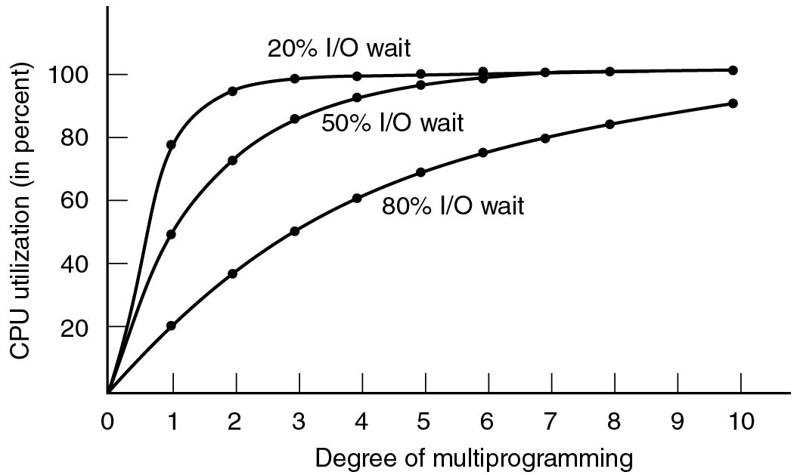
Modeling Multiprogramming
Figure 2.6 C P U utilization as a function of the number of processes in memory.
Notes:
Long Description:
The horizontal axis is labeled Degree of multiprogramming and ranges from 0 to 10 in increments of 1 unit. The vertical axis is labeled C P U utilization (in percent) and ranges from 0 to 100 in increments of 20 units. Three different curves are shown here. The first curve labeled 20 percent I/O wait starts at (0, 0), rises toward the upper right, is concave downward, then rises linearly to the point (1, 80), bends, moves horizontally and ends at (10, 100). The second curve labeled 50 percent I/O wait, starts at (0, 0), rises upward to the right, is concave downward, then merges with the first curve at the point (6, 100) and ends at (10, 100). Several points are marked on this line as follows: (1, 50), (2, 70), (3, 85), (5, 95), and (8, 100). The third curve labeled 80 percent I/O wait starts at (0, 0), rises toward the upper right, is concave upward, and ends at (10, 100). The curve passes through the following points: (1, 20), (2, 40), (3, 50), (5, 70), (6, 75), (7, 80), and (8, 95).

Slide 20
Signal Handling (1 of 2)
Signal types:
Hardware-induced (e.g., S I G I L L)
Software-induced (e.g., S I G Q U I T or S I G P I P E)
Actions:
Term, I g n, Core, Stop, Cont
Default action on per-signal basis, typically overridable
Signals can be typically blocked and actions delayed
Catching signals:
Process registers signal handler
OS delivers signal and allows process to run handler
Current execution context needs to be saved/restored

Slide 21
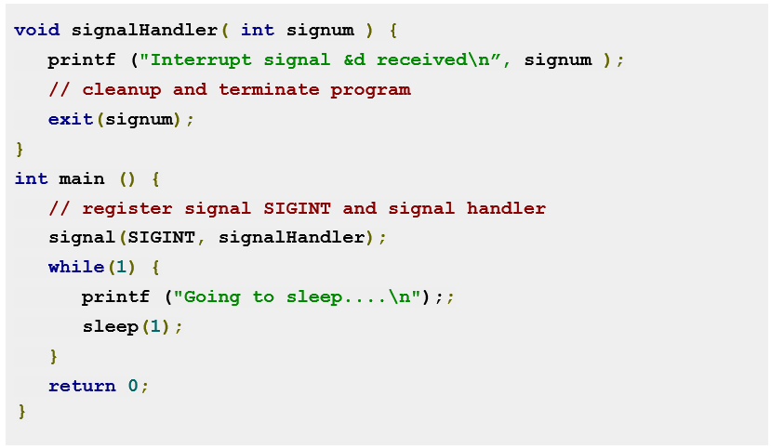
Catching Ctrl-C
Notes:
Long Description:
The code lines from top to bottom are as follows.
void signal handler left parenthesis int signum right parenthesis left brace
print f left parenthesis double quotation interrupt signal and d received backward slash n double quotation comma signum right parenthesis semicolon
double forward slash cleanup and terminate program
exit left parenthesis signum right parenthesis semi colon
right brace
int main left parenthesis right parenthesis left brace
double forward slash register signal S I G I N T and signal handler
signal left parenthesis S I G I N T comma signal handler right parenthesis semicolon
while left parenthesis 1 right parenthesis left brace
print f left parenthesis double quotation going to sleep four dots backward slash n double quotation right parenthesis semicolon semicolon
sleep left parenthesis 1 right parenthesis semicolon
right brace
return 0 semicolon
right brace

Slide 22
Signal Handling (2 of 2)
Kernel delivers signal
Stops code currently executing
Saves context
Executes signal handling code
Restores original context

Slide 23
Threads

Slide 24
Threads
Implicit assumption so far:
1 process
1 thread of execution
Multithreaded execution:
1 process
N threads of execution
Why allow multiple threads per process?
Lightweight processes
Allow space- and time- efficient parallelism
Organized in thread groups
Allow simple communication and synchronization

Slide 25
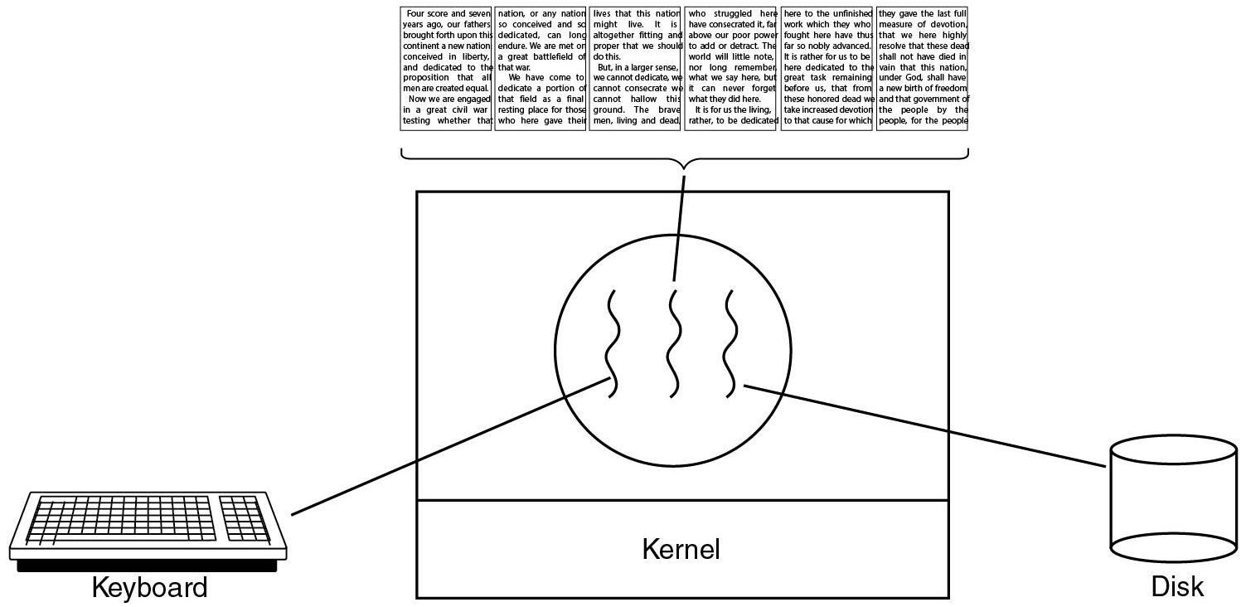
Thread Usage (1)
Figure 2.7 A word processor with three threads.
Notes:
Long Description:
The image consists of a square block in the center with two horizontal partitions. A circle with three wavy lines is in the first partition and the second partition is labeled kernel. There is a keyboard on the left connected with the first wavy line in the circle and a cylindrical disk on the right connected with the third wavy line of a circle. Six pages of a book are shown on the top of the square and are connected with the center wavy line of a circle. The pages of the book are about a nation's liberty, dedication, devotion, and freedom and the idea government of the people, by the people, and for the people.

Slide 26
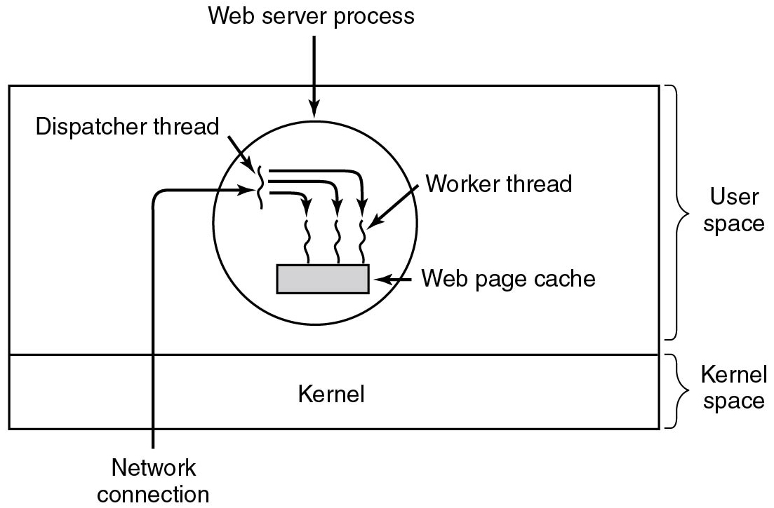
Thread Usage (2)
Figure 2.8 A multithreaded Web server.
Notes:
Long Description:
There is a rectangular block with two horizontal partitions. The first partition has a circle labeled Web server process with three wavy lines placed on a small rectangular block labeled Web page cache. There is a fourth wavy line in the upper left region of the circle labeled Dispatcher thread and an outside Network connection also points to it with a forward arrow. There are three downward arrows from this fourth wavy line that points to three wavy lines in a circle. The third wavy line in a circle is labeled worker thread. The second partition is labeled Kernel. The first partition is categorized as User-space and the second partition is categorized as Kernel space.

Slide 27
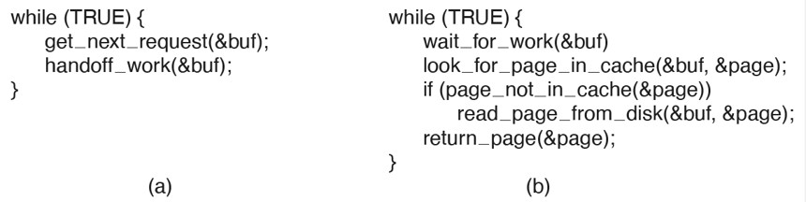
Thread Usage (3)
Figure 2.9 A rough outline of the code for Figure 2.8. (a) Dispatcher thread. (b) Worker thread.
Notes:
Long Description:
The 4 line of code for figure a are as follows.
while open parenthesis TRUE close parenthesis open curly bracket
get under score next under score request open parenthesis ampersand buf close parenthesis semi colon
handoff under score work open parenthesis ampersand buf close parenthesis semi colon
close curly bracket
The 7 lines of code for figure open parenthesis b close parenthesis are as follow
while open parenthesis TRUE close parenthesis open curly bracket
wait under score for under score work open parenthesis &buf close parenthesis
look under score for under score page under score in under score cache open parenthesis ampersand buf coma ampersand page close parenthesis semi colon
if open parenthesis page under score not under score in under score cache open parenthesis ampersand page close parenthesis close parenthesis
read under score page under score from under score disk open parenthesis ampersand buf coma ampersand page close parenthesis semi colon
return under score page open parenthesis ampersand page close parenthesis semi colon
close curly bracket

Slide 28
Threads, Process, Finite State Machine
Model | Characteristics
Threads | Parallelism, blocking system calls
Single-threaded process | No parallelism, blocking system calls
Finite-state machine | Parallelism, nonblocking system calls, interrupts

Slide 29
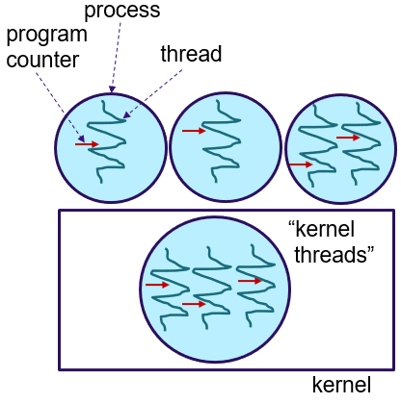
Threads and Processes
Threads reside in the same address space of a single process
All information exchange is via data shared between the threads
Threads synchronize via simple primitives
Each thread has its own stack, hardware registers, and state
Thread table/switch: a lighter process table/switch
Each thread may call any O S-supported system call on behalf of the process to which it belongs
Notes:
Long Description:
The block is labeled as a kernel and the circle inside is labeled the kernel threads. Each circle has lines inside them. The circle on top is labeled process, the lines inside are labeled the thread, and the arrows pointing to the thread are labeled program counter.

Slide 30
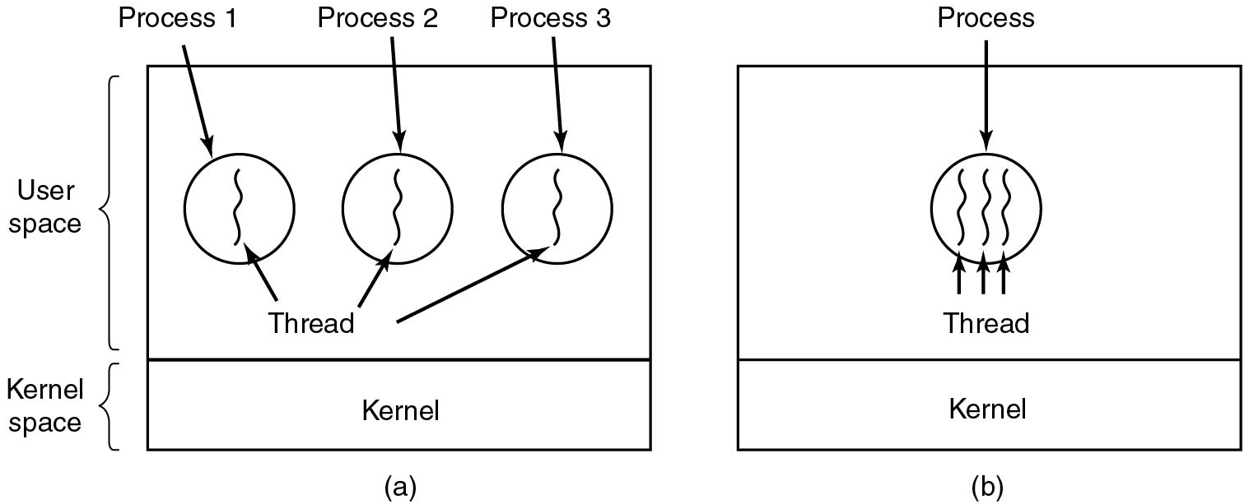
The Classical Thread Model (1)
Figure 2.10 (a) Three processes each with one thread. (b) One process with three threads.
Notes:
Long Description:
Part (a): There is a rectangular block with two horizontal partitions. The top first partition has three circles labeled Process 1, Process 2, and Process 3 with one wavy line in each circle labeled Thread. The second partition is labeled Kernel. The first partition is categorized as User-space and the second partition is categorized as kernel space. Part (b): There is a rectangular block with two horizontal partitions. The top first partition has a circle labeled Process with three wavy lines, each labeled Thread. The second partition is labeled Kernel.

Slide 31
The Classical Thread Model (2)
Per process items | Per thread items
Address space Global variables Open files Child processes Pending alarms Signals and signal handlers Accounting information | Program counter Registers Stack State
Figure 2.11 The first column lists some items shared by all threads in a process. The second one lists some items private to each thread.

Slide 32
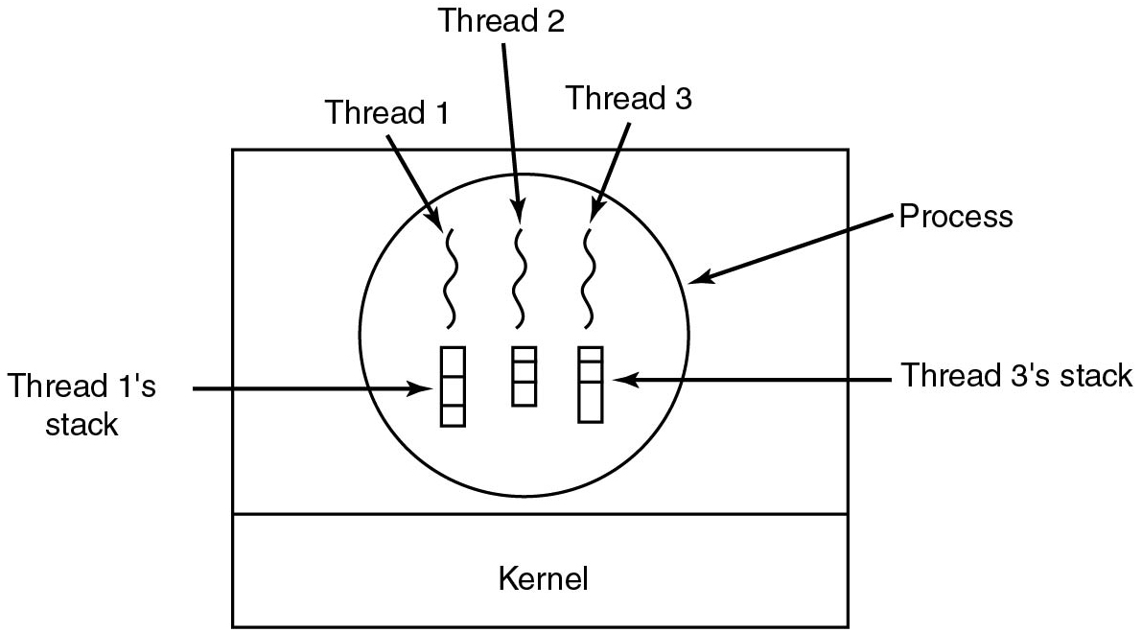
The Classical Thread Model (3)
Figure 2.12 Each thread has its own stack.
Notes:
Long Description:
There is a rectangular block with two horizontal partitions. The top first partition has a circle labeled Process with three wavy lines labeled Thread 1, Thread 2, and Thread 3, inside the circle. There are three vertical rectangular blocks with three horizontal partitions. The first vertical rectangular block labeled Thread 1's stack and the third labeled Thread 3's stack. The second partition is labeled Kernel.

Slide 33
P O S I X Threads (1 of 2)
Thread call | Description
P thread_create | Create a new thread
p thread_exit | Terminate the calling thread
p thread_join | Wait for a specific thread to exit
p thread_yield | Release the C P U to let another thread run
p thread_attr_init | Create and initialize a thread's attribute structure
p thread_attr_destroy | Remove a thread's attribute structure
Figure 2.13 Some of the P threads function calls.

Slide 34
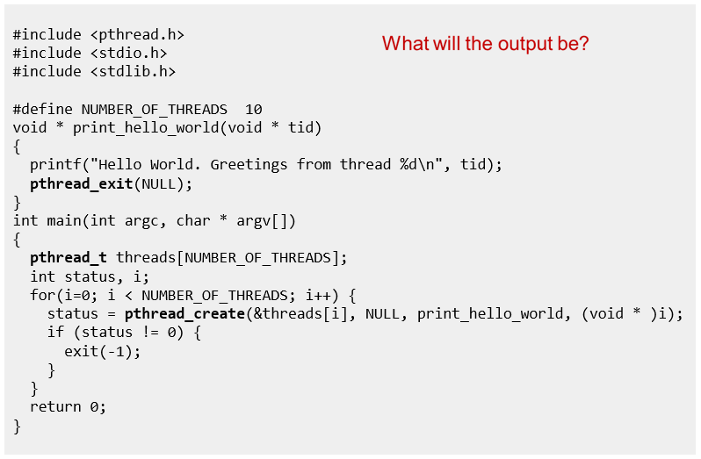
P threads
Notes:
A: 10x “Hello World. Greetings from thread …” in arbitrary order
Long Description:
The code from top to bottom is as follows.
hashtag include left angle bracket p thread dot h right angle bracket
hashtag include left angle bracket stdio dot h right angle bracket
hashtag include left angle bracket stdlib dot h right angle bracket
hashtag define NUMBER underscore OF underscore THREADS 10
void asterisk print underscore hello underscore world left parenthesis void asterisk t i d right parenthesis
left brace
print f left parenthesis double quote Hello World. Greetings from thread percent d backward slash n double quote comma t i d right parenthesis semi colon
p thread underscore exit left parenthesis NULL right parenthesis semi colon
right brace
int main left parenthesis int arg c comma char asterisk arg v left bracket right bracket right parenthesis
left brace
p thread underscore t threads left bracket NUMBER underscore OF underscore THREADS right bracket semi colon
int status comma i semi colon
for left parenthesis i equal 0 semicolon i left angle bracket NUMBER underscore OF underscore THREADS semicolon i plus plus right parenthesis left brace
status equal p thread underscore create left parenthesis and thread left bracket i right bracket comma NULL comma print underscore hello underscore world comma left parenthesis void asterisk right parenthesis i right parenthesis semi colon
if left parenthesis status exclamation mark equals 0 right parenthesis left brace
exit left parenthesis negative 1 right parenthesis semi colon
right brace
right brace
return 0 semicolon
right brace
What will the output be?

Slide 35
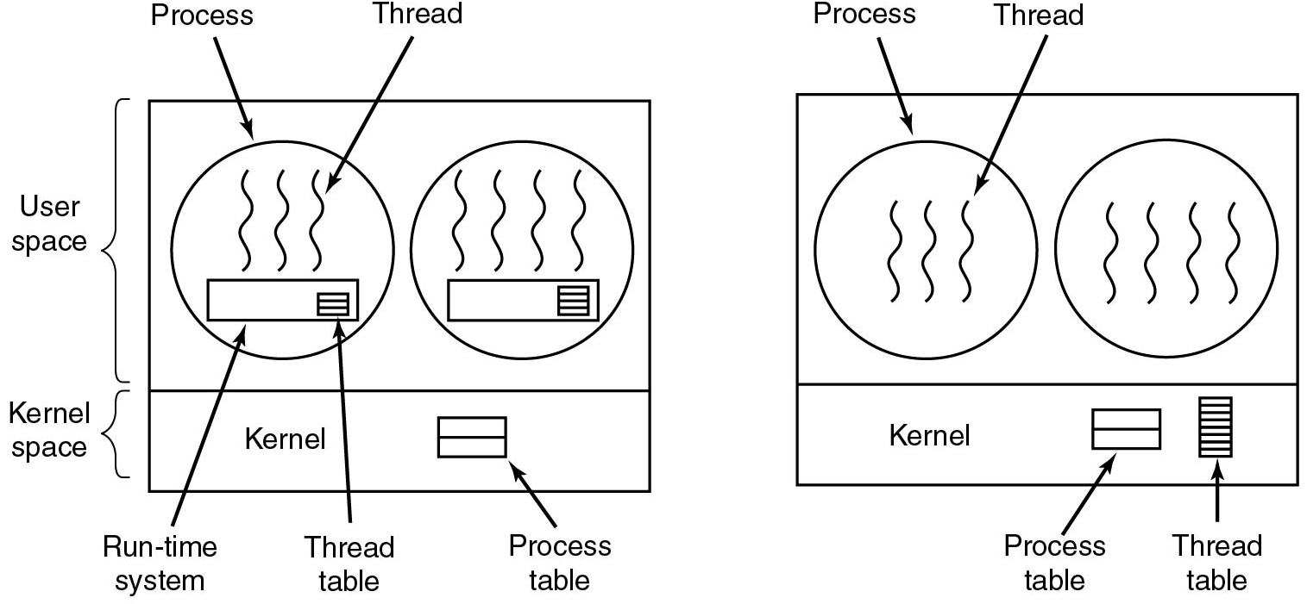
Implementing Threads in User Space
Figure 2.15 (a) A user-level threads package. (b) A threads package managed by the kernel.
Notes:
Long Description:
The image consists of two parts. Part 1: There is a rectangular block with two horizontal partitions. The first partition is categorized as User-space and the second is kernel space. The top first partition has two circles. The first circle labeled Process has three vertical wavy lines labeled Thread. There is a rectangular block labeled Run time system with another small block labeled Thread table with three partitions. The second circle is the same as the first one, except that there is an extra wavy line in the circle. The second partition is labeled Kernel and a block with two horizontal partitions labeled Process table. Part 2: It is the same as part 1 except that there are no rectangular blocks in both circles. A rectangular block labeled thread table has many partitions is at the lower right end of the kernel space.

Slide 36
User Threads: Pros and Cons
+ Thread switching time (no mode switch)
+ Scalability, customizability (no in-kernel management)
- Transparency (typically requires app cooperation)
- Parallelism (blocking syscalls are problematic)
Notes:
Long Description:
The image consists of two parts. Part 1: There is a rectangular block with two horizontal partitions. The first partition is categorized as User-space and the second is kernel space. The top first partition has two circles. The first circle labeled Process has three vertical wavy lines labeled Thread. There is a rectangular block labeled Run time system with another small block labeled Thread table with three partitions. The second circle is the same as the first one, except that there is an extra wavy line in the circle. The second partition is labeled Kernel and a block with two horizontal partitions labeled Process table. Part 2: It is the same as part 1 except that there are no rectangular blocks in both circles. A rectangular block labeled thread table has many partitions is at the lower right end of the kernel space.

Slide 37
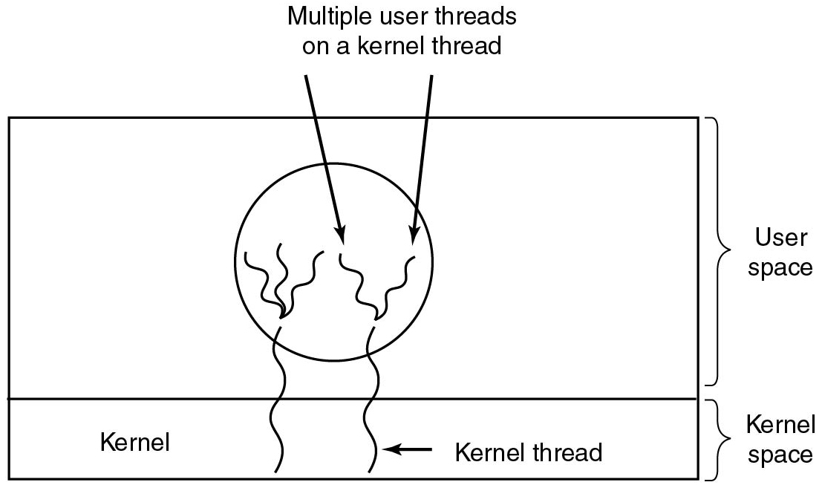
Hybrid Implementations
Figure 2.16 Multiplexing user-level threads onto kernel-level threads.
Notes:
Long Description:
A rectangular block has two horizontal partitions. The top first partition has a circle with multiple vertical wavy lines labeled Multiple user threads on a kernel thread. The second partition is labeled Kernel and two vertical wavy lines labeled kernel thread from the circle in the first partition enter the second partition. The first partition is categorized as User-space and the second partition is categorized as kernel space.

Slide 38
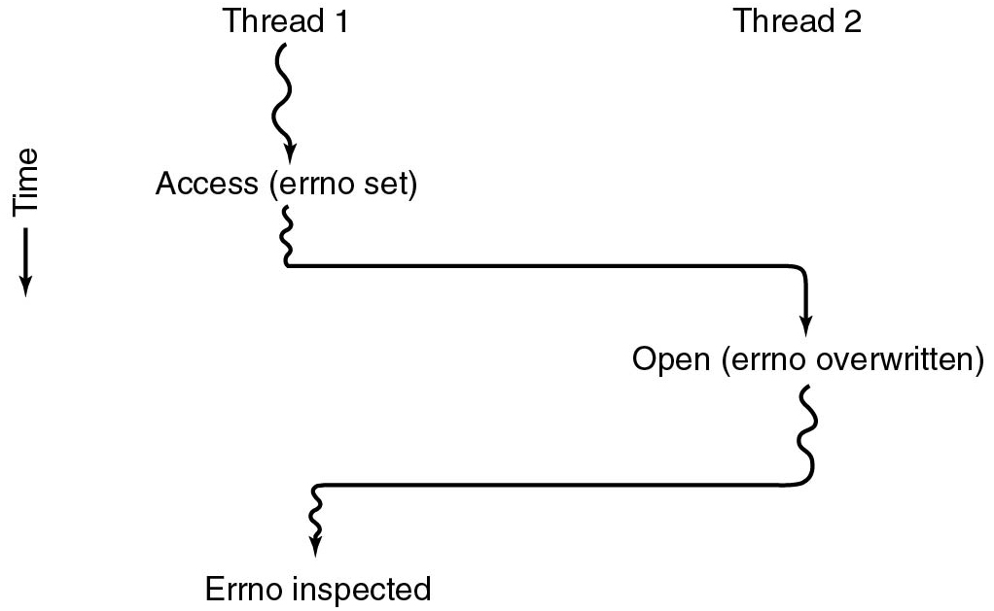
Making Single-Threaded Code Multithreaded (1)
Figure 2.17 Conflicts between threads over the use of a global variable.
Notes:
Long Description:
There are two vertical wavy lines labeled Thread 1 and thread 2. The vertical direction depicts time. Thread 1 is split into two parts and one of the parts is labeled Access (Errno set). Thread 1 then travels toward the right for a while, bends down with a downward arrow labeled Open (Errno overwritten). Then thread 2 travels toward the left for a while, bends down with a downward wavy arrow labeled Errno Inspected.

Slide 39
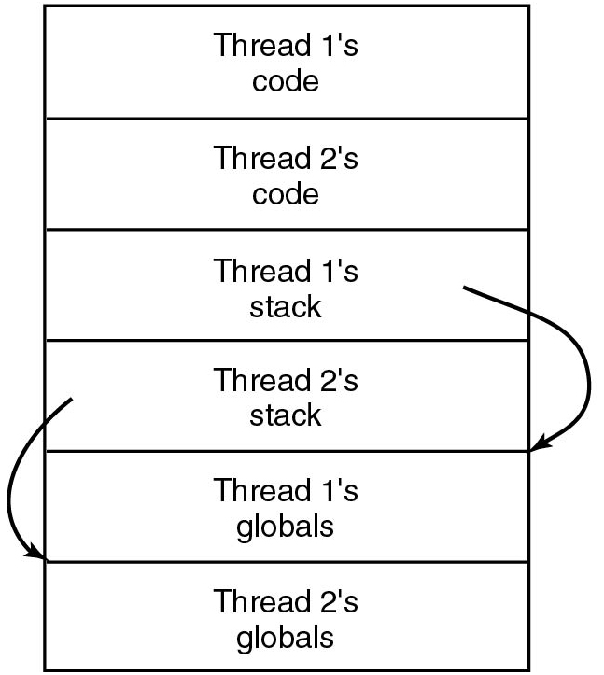
Making Single-Threaded Code Multithreaded (2)
Figure 2.18 Threads can have private global variables.
Notes:
Long Description:
A rectangular block has six partitions from top to bottom labeled Thread 1's code, Thread 2's code, Thread 1's stack, Thread 2's stack, Thread 1's globals, and Thread 2's globals. A circular arrow from Thread 1's stack points to Thread 1's globals. Another circular arrow from Thread 2's stack points to Thread 2's globals.

Slide 40
Threads: Issues
Does the O S keep track of threads?
Kernel threads versus. user threads
What to do on fork?
Clone all threads versus. calling thread
What if a thread is currently blocking on a systems call?
What to do with signals?
Send signal to all threads versus. single thread
Per-process or per-thread signal handlers
Where to store per-thread variables?
Does sharing come at a cost?
Are threads required inside an operating system?
Notes:
Pthreads on Linux: The child process is created with a single thread—the one that called fork(). Thus: only the calling thread is replicated, not other threads. On other operating systems (e.g. Solaris) you can choose what fork does depending on what library you link to)
The entire virtual address space of the parent is replicated in the child, including the states of mutexes, condition variables, and other pthreads objects; the use of
Signals: Signals are sent to a process, handled by one of the threads
Per-thread variables: T L S (Thread Local Storage)
pthread_atfork(3) may be helpful for dealing with problems that this can cause.

Slide 41
Event-Driven Servers
Implement server as finite-state machine that responds to events using asynchronous system calls
E.g., the availability of data on a socket
Implementation can be very efficient
Every event leads to a burst of activity without blocking
Most O S offer event notification interfaces for asynchronous I/O
Linus: epoll
FreeB S D: kqueue

Slide 42
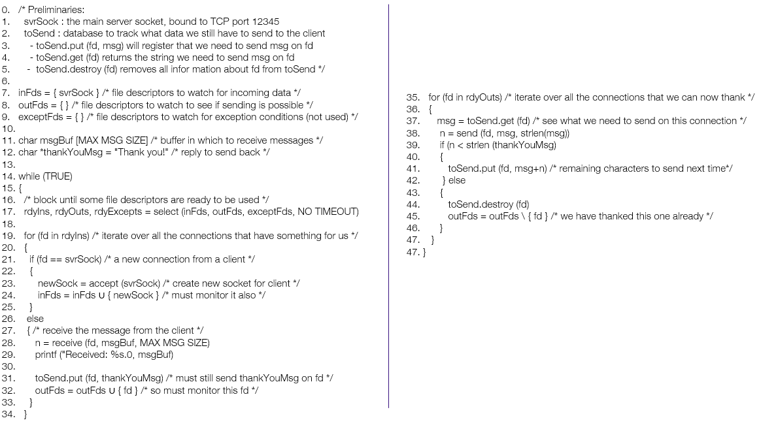
Event-Driven Server
Notes:
Long Description:
The code from top to bottom is as follows.
0. forward slash asterisk Preliminaries colon
1. svr Sock colon the main server socket comma bound to T C P port 12345
2. to Send colon database to track what data we still have to send to the client
3. dash to Send dot put right parenthesis f d comma msg right parenthesis will register that we need to send msg on f d
4. dash to Send dot get left parenthesis f d right parenthesis returns the string we need to send msg on f d
5. dash to Send dot destroy left parenthesis f d right parenthesis removes all information about f d from to Send asterisk forward slash
6.
7. in F d s equals to left brace svr S oc k right brace forward slash asterisk file descriptors to watch for incoming data asterisk forward slash
8. out F d s equals to left brace right brace forward slash asterisk file descriptors to watch to see if sending is possible asterisk forward slash
9. except F d s equals to left brace right brace forward slash asterisk file descriptors to watch for exception conditions left parenthesis not used right parenthesis asterisk forward slash
10.
11. char msg Buf left bracket MAX MSG SIZE right bracket forward slash asterisk buffer in which to receive messages asterisk forward slash
12. char asterisk thank You Msg equals to double quotation Thank you exclamation mark double quote forward slash asterisk reply to send back asterisk forward slash
13.
14. while left parenthesis TRUE right parenthesis
15. left brace
16. forward slash asterisk block until some file descriptors are ready to be used asterisk forward slash
17. Rdy Ins comma rdy Outs comma r d y Excepts equals select left parenthesis in Fds comma out Fds comma except Fds comma NO TIMEOUT right parenthesis
18.
19. for left parenthesis f d in rdy lns right parenthesis forward slash asterisk iterate over all the connections that have something for us asterisk forward slash
20. left brace
21. if left parenthesis f d equals equals svr sock right parenthesis forward slash asterisk a new connection from a client asterisk forward slash
22. left brace
23. New Sock equals to accept left parenthesis svr sock right parenthesis forward slash asterisk create new socket for client asterisk forward slash
24. In Fds equals to in Fds left brace new Sock right brace forward slash asterisk must monitor it also asterisk forward slash
25. right brace
26. else
27. left brace forward slash asterisk receive the message from the client asterisk forward slash
28. n equals receive left parenthesis f d comma msg B u f comma MAX MSG SIZE right parenthesis
29. Print f left parenthesis double quotation Received colon percent s dot 0 comma msg B u f right parenthesis
30.
31. to send dot put left parenthesis f d comma thank you msg right parenthesis forward slash asterisk must still send thank you msg on f d asterisk forward slash
32. out F d s equals to out F d s left brace f d right brace forward slash asterisk so must monitor this f d asterisk forward slash
33. right brace
34. right brace
35. for left parenthesis f d in r d y out s right parenthesis forward slash asterisk iterate over all the connections that we can now thank asterisk forward slash
36. left brace
37. msg equals left parenthesis f d right parenthesis forward slash asterisk see what we need to send on this connection asterisk forward slash
38. n equals to send left parenthesis f d comma msg comma strlen left parenthesis msg right parenthesis right parenthesis
39. if left parenthesis n right angle bracket strlen left parenthesis thank right parenthesis
40. left brace
41. to send dot put left parenthesis f d comma msg plus n right parenthesis forward slash asterisk remaining characters to send next time asterisk forward slash
42. right brace else
43. left brace
44. to send dot destroy left parenthesis f d right parenthesis
45. out F d s equals to out F d s backward slash left brace f d right brace forward slash asterisk we have thanked this one already asterisk forward slash
46. right brace
47. right brace
47. right brace

Slide 43
Single-Threaded VersuS Multi-threaded VersuS Event-Driven Servers
Model | Characteristics
Threads | Parallelism, blocking system calls
Single-threaded process | No parallelism, blocking system calls
Finite-state machine | Parallelism, nonblocking system calls, interrupts
Figure 2.20 Three ways to construct a server.

Slide 44
Synchronization and Inter-Process Communication (I P C)
Why?
Processes need some way to communicate:
To share data throughout the execution
No explicit cross-process sharing:
Data must be normally exchanged between processes
Processes need some way to synchronize:
To account for dependencies
To avoid they get in each other’s way
Also applies to multithreaded execution

Slide 45
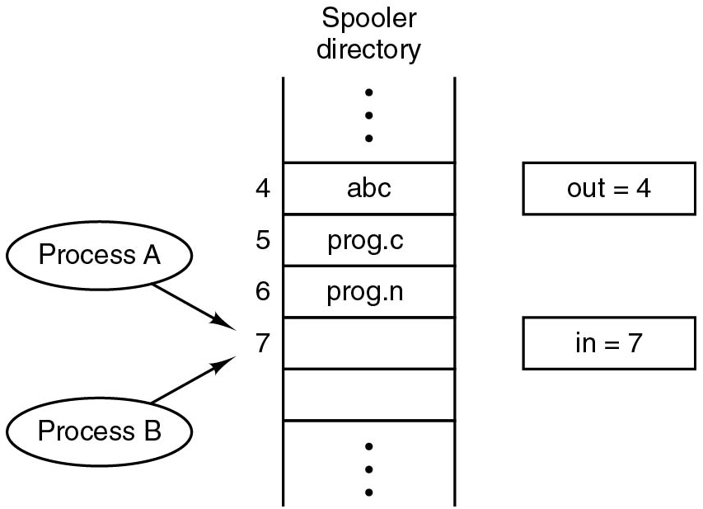
Race Conditions
Process A reads in=7 and decides to append its file at that position
A is suspended by O S (because its slott expired)
Process B also reads in=7 and puts its file at that position
B sets in=8 and eventually gets suspended.
A writes its file to position 7
Problem: reading/updating in should be an atomic action. If it is not, processes can race each other and come to wrong conclusions
Notes:
Long Description:
There are two vertical lines with multiple partitions labeled Spooler directory. Some partitions are labeled 4, 5, 6, and 7 from top to bottom. There are two oval-shaped blocks on the left labeled Process A and Process B with forwarding arrows pointing to the seventh partition. There are two rectangular blocks on the right labeled out equals 4 and in equals 7, respectively, from top to bottom.

Slide 46
Critical Regions (1)
Requirements to avoid race conditions:
No two processes may be simultaneously inside their critical regions.
No assumptions may be made about speeds or the number of C P U s.
No process running outside its critical region may block other processes.
No process should have to wait forever to enter its critical region.

Slide 47
Critical Regions (2)
Critical region: a code region with access to shared resources
No two processes may be simultaneously in their critical regions
No assumptions may be made about speeds or nr. of C P U s
No process running outside its critical region may block others
No process should have to wait forever to enter its critical region
(Non)solutions:
Disable interrupts: simply prevent that the C P U can be reallocated. Works for single-C P U systems only
Lock variables: guard critical regions with 0/1 variables. Races now occur on the lock variables themselves

Slide 48
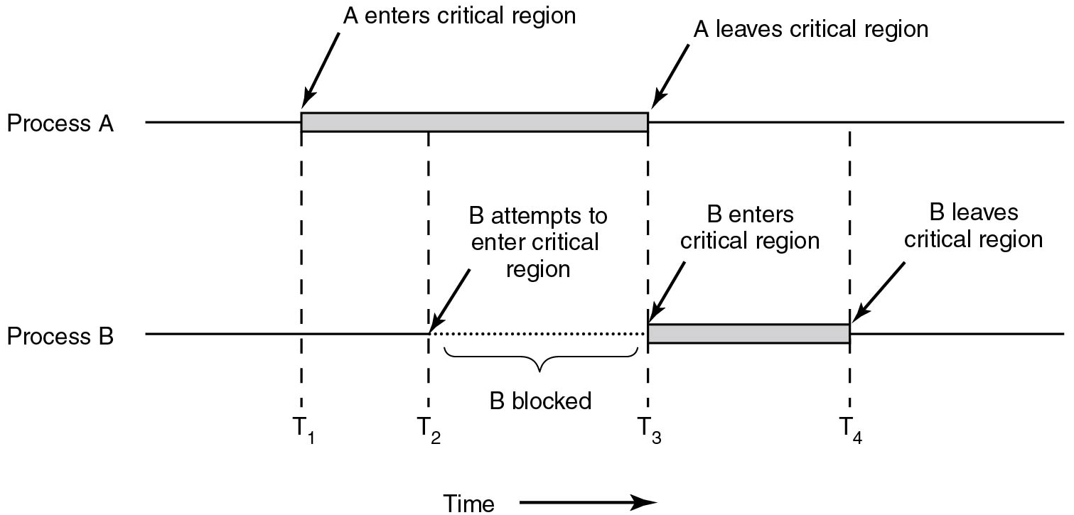
Critical Regions (3)
Figure 2.22 Mutual exclusion using critical regions.
Notes:
Long Description:
The horizontal direction represents time. The image consists of two parts labeled Process "A" and Process B. A straight horizontal line labeled Process "A" has a horizontal rectangular block placed on it nearly at the center. An arrow "A" enters the critical region points to the left end of the block. Another arrow labeled "A" leaves the critical region points to the right end of the block. A straight horizontal line labeled Process B has a horizontal rectangular block placed on it exactly at the point where the rectangular block of Process "A" ends. An arrow labeled B enters the critical region points to the left end of the block. Another arrow labeled B leaves the critical region points to the right end of the block. There are four time intervals labeled T1, T2, T3, and T4 from left to right. The T1 time cycle is marked from where A enters the critical region, enters process B, and exits. The T2 time cycle is marked from where the Process "A" block, attempts to enter process B, and exits. The T3 time cycle is marked from where "A" leaves the critical region, enters process B. The T4 time cycle is marked from process A end of the line enters B where B leaves the critical region. The area between T2 and T3 is labeled B attempts to enter the critical region, line of Process B at this point is a dotted line and marked as B blocked.

Slide 49
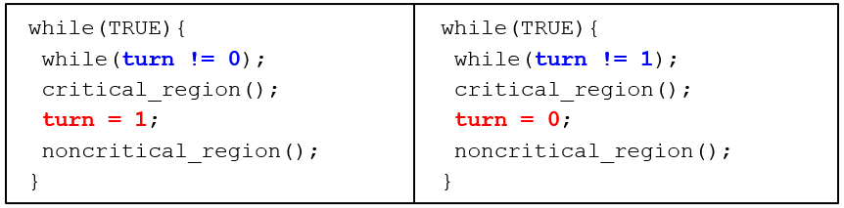
Mutual Exclusion with Busy Waiting: Strict Alternation
Unfortunately, this is yet another (non)solution:
Does not permit processes to enter their critical regions two times in a row
A process outside the critical region can effectively block another one
Notes:
Long Description:
The code for the first set on the left from top to bottom is as follows.
while left parenthesis TRUE right parenthesis left brace
while left parenthesis turn exclamation mark equals to 0 right parenthesis semicolon
critical underscore region left parenthesis right parenthesis semicolon
turn equals to 1 semi-colon
noncritical underscore region left parenthesis right parenthesis semicolon
right brace
The code for the second set on the right from top to bottom is as follows.
while left parenthesis TRUE right parenthesis left brace
while left parenthesis turn exclamation mark equals to 1 semicolon
critical underscore region left parenthesis right parenthesis semicolon
turn equals to 0 semicolon
noncritical underscore region left parenthesis right parenthesis semicolon
right brace

Slide 50
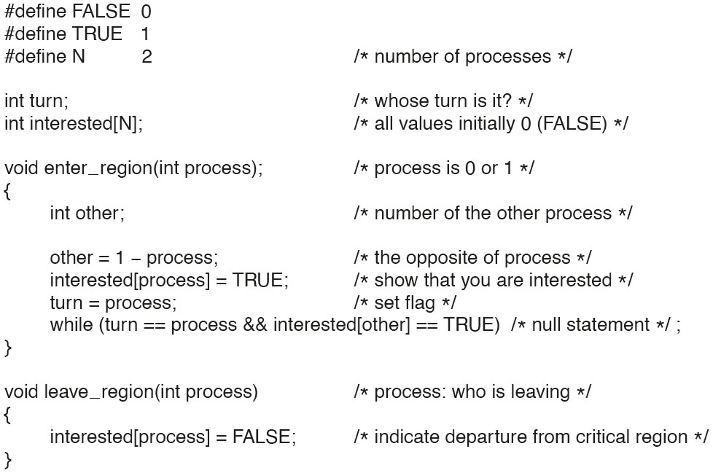
Mutual Exclusion with Busy Waiting: Peterson’s Solution
Figure 2.24. Peterson’s solution for achieving mutual exclusion.
Notes:
Long Description:
hash define FALSE 0
hash define TRUE 1
hash define N 2 forward slash asterisk number of processes asterisk forward slash
int turn semicolon forward slash asterisk whose turn is it question mark asterisk forward slash
int interested open box bracket N close box bracket semicolon forward slash asterisk all values initially 0 open parenthesis FALSE close parenthesis asterisk forward slash
void enter underscore region open parenthesis int process close parenthesis semicolon forward slash asterisk process is 0 or 1 asterisk forward slash
open curly bracket
int other semicolon forward slash asterisk number of the other process asterisk forward slash
other equals 1 minus process semicolon forward slash asterisk the opposite of process asterisk forward slash
interested open box bracket process close box bracket equals TRUE semicolon forward slash asterisk show that you are interested asterisk forward slash
turn equals process semicolon forward slash asterisk set flag asterisk forward slash
while open parenthesis turn equals equals process ampersand ampersand interested open box bracket other close box bracket equals equals TRUE close parenthesis forward slash asterisk null statement asterisk forward slash semicolon
close curly bracket
void leave underscore region open parenthesis int process close parenthesis forward slash asterisk process colon who is leaving asterisk forward slash
open curly bracket
interested open box bracket process close box bracket equals FALSE semicolon forward slash asterisk indicate departure from critical region asterisk close parenthesis
close curly bracket

Slide 51
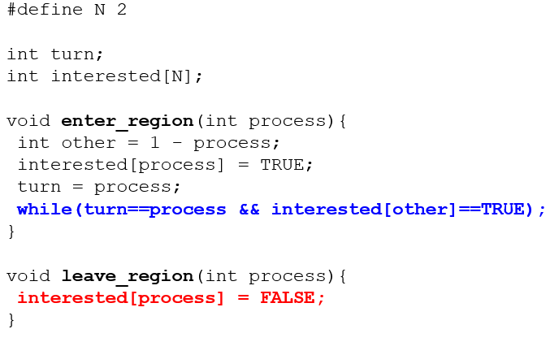
Mutual Exclusion with Busy Waiting: Peterson’s algorithm
Notes:
Long Description:
The code from top to bottom reads as follows.
hash define N 2
int turn semicolon
int interested left bracket N right bracket semicolon
void enter underscore region left parenthesis int process right parenthesis left brace
int other equals 1 minus process semicolon
interested left bracket process right bracket equals TRUE semicolon
turn equals process semicolon
while left parenthesis turn equals equals process ampersand ampersand interested left bracket other right bracket equals equals TRUE right parenthesis
right brace
void leave underscore region left parenthesis int process right parenthesis left brace
interested left bracket process right bracket equals FALSE semicolon
right brace

Slide 52
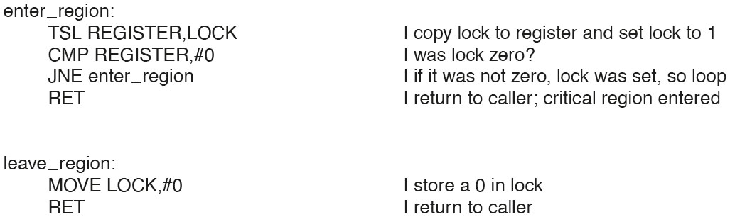
Mutual Exclusion with Busy Waiting: The T S L Instruction (1 of 2)
Figure 2.25. Entering and leaving a critical region using the T S L instruction.
Notes:
Long Description:
enter underscore region colon
TSL REGISTER coma LOCK vertical line copy lock to register and set lock to 1
CMP REGISTER coma hash 0 vertical line was lock zero question mark
JNE enter underscore region vertical line if it was not zero coma lock was set coma so loop
RET vertical line return to caller semicolon critical region entered
leave underscore region colon
MOVE LOCK coma hash 0 vertical line store a 0 in lock
RET vertical line return to caller

Slide 53
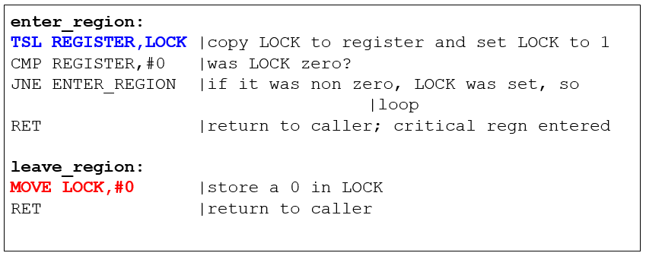
Mutual Exclusion with Busy Waiting: The T S L Instruction (2 of 2)
Hardware-assisted solution to the mutual exclusion problem
Atomic test and set of a memory value
Spin until LOCK is acquired
Notes:
Long Description:
The instruction from top to bottom are as follows.
enter underscore region colon
T S L REGISTER comma LOCK vertical bar copy lock to register and set lock to 1
C M P REGISTER comma hashtag 0 vertical bar was lock zero question mark
J N E enter underscore region vertical bar if it was non zero comma lock was set comma so vertical bar loop
R E T vertical bar return to caller semicolon critical r e g n entered
leave underscore region colon
MOVE LOCK comma hashtag 0 vertical bar store a 0 in lock
R E T vertical bar return to caller

Slide 54
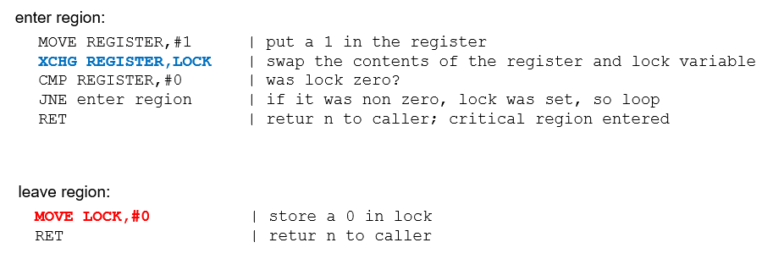
Mutual Exclusion with Busy Waiting: The X C H G Instruction
Figure 2.26 Entering and leaving a critical region using the X C H G instruction
Notes:
Long Description:
enter underscore region colon
MOVE REGISTER coma hash 1 vertical line put a 1 in the register
XCHG REGISTER coma LOCK vertical line swap the contents of the register and lock variable
CMP REGISTER coma hash 0 vertical line was lock zero question mark
JNE enter underscore region vertical line if it was non zero coma lock was set coma so loop
RET vertical line return to caller semicolon critical region entered
leave underscore region colon
MOVE LOCK coma hash 0 vertical line store a 0 in lock
RET vertical line return to caller

Slide 55
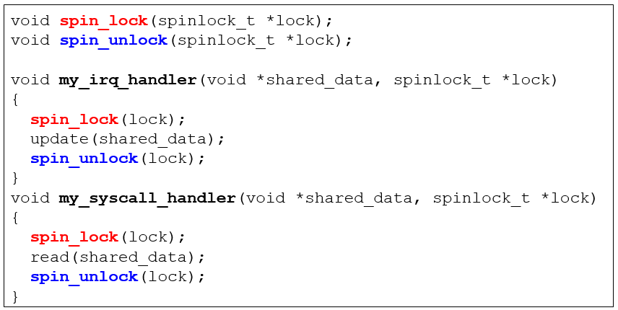
Spinlocks and Spinlock Problems
What would happen when we get an interrupt after the syscall handler has taken the lock?
Notes:
If irq is off when my_irq_handler is called, we have a deadlock
Long Description:
The code from top to bottom reads as follows.
void spin underscore lock left parenthesis spinlock, underscore, T asterisk lock left parenthesis, semicolon.
void spin underscore unlock left parenthesis spinlock, underscore, T asterisk lock left parenthesis, semicolon.
void my underscore I R Q under score handler, right parenthesis, void asterisk shared underscore data, comma spinlock, underscore T asterisk lock.
left brace
spin underscore lock left parenthesis lock right parenthesis semicolon
update left parenthesis shared underscore data right parenthesis semicolon
spin underscore unlock left parenthesis lock right parenthesis semicolon
right brace
void my underscore syscall underscore handler left parenthesis void asterisk shared underscore data comma spinlock underscore t asterisk lock
left brace
spin underscore lock left parenthesis lock right parenthesis semicolon
read left parenthesis shared underscore data right parenthesis semicolon
spin underscore unlock left parenthesis lock right parenthesis semicolon
right brace

Slide 56
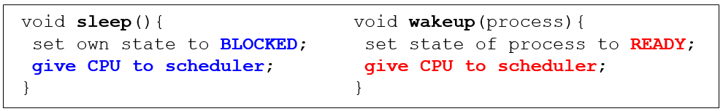
Avoiding Busy Waiting
The solutions so far let a process keep the C P U busy waiting until it can enter its critical region (spin lock)
Solution: let a process waiting to enter its critical region return the C P U to the scheduler voluntarily
Notes:
Long Description:
The code from top to bottom in the first set is as follows.
void sleep left parenthesis right parenthesis left brace
set own state to blocked semicolon
give C P U to scheduler
right brace
void wakeup left parenthesis process right parenthesis left brace
set state of process to ready semicolon
give C P U to scheduler
right brace

Slide 57
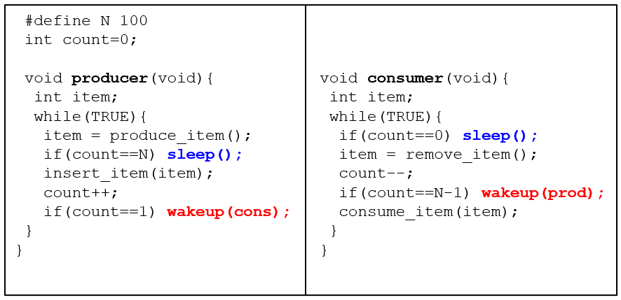
Producer-Consumer (1 of 4)
Notes:
Race condition. It can occur because access to count is unconstrained. As a consequence, the following situation could possibly occur. The buffer is empty and the consumer has just read count to see if it is 0. At that instant, the scheduler decides to stop running the consumer temporarily and start running the producer. The producer inserts an item in the buffer, increments count, and notices that it is now 1. Reasoning that count was just 0, and thus the consumer must be sleeping, the producer calls wakeup to wake the consumer up. Unfortunately, the consumer is not yet logically asleep, so the wakeup signal is lost. When the consumer next runs, it will test the value of count it previously read, find it to be 0, and go to sleep. Sooner or later the producer will fill up the buffer and also go to sleep. Both will sleep forever.
The essence of the problem here is that a wakeup sent to a process that is not (yet) sleeping is lost. If it were not lost, everything would work. A quick fix is to modify the rules to add a wakeup waiting bit to the picture. When a wakeup is sent to a process that is still awake, this bit is set. Later, when the process tries to go to sleep, if the wakeup waiting bit is on, it will be turned off, but the process will stay awake. The wakeup waiting bit is a piggy bank for storing wakeup signals.
The consumer clears the wakeup waiting bit in every iteration of the loop
Long Description:
The code from top to bottom is as follows.
hashtag define N 100
int count equals 0 semicolon
void producer left parenthesis void right parenthesis left brace
int item semicolon
while left parenthesis TRUE right parenthesis left
item equals produce underscore item left parenthesis right parenthesis semicolon
if left parenthesis count equals equals N right parenthesis sleep left parenthesis right parenthesis semicolon
insert underscore item left parenthesis item right parenthesis semicolon
count plus plus semicolon
if left parenthesis count equals equals 1 right parenthesis wakeup left parenthesis cons right parenthesis semicolon
right brace
right brace
void consumer left parenthesis void right parenthesis left brace
int item semicolon
while left parenthesis TRUE right parenthesis left brace
if left parenthesis count equals equals 0 right parenthesis sleep left parenthesis right parenthesis semicolon
item equals remove underscore item left parenthesis right parenthesis semicolon
count minus minus
if left parenthesis count equals equals N minus 1 right parenthesis wakeup left parenthesis p r o d right parenthesis semicolon
consume underscore item left parenthesis item right parenthesis semicolon
right brace
right brace

Slide 58
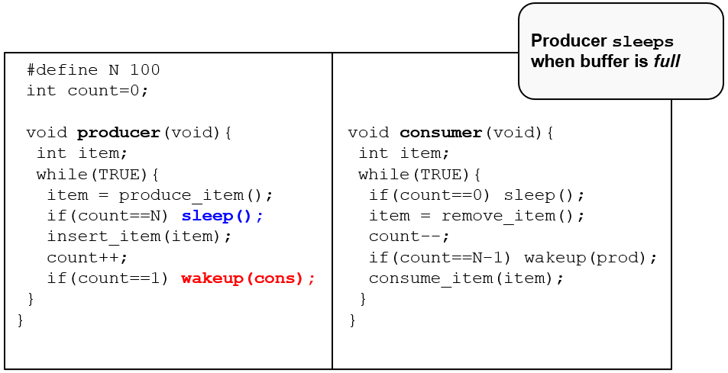
Producer-Consumer (2 of 4)
Notes:
Long Description:
The code from top to bottom is as follows.
hashtag define N 100
int count equals 0 semicolon
void producer left parenthesis void right parenthesis left brace
int item semicolon
while left parenthesis TRUE right parenthesis left
item equals produce underscore item left parenthesis right parenthesis semicolon
if left parenthesis count equals equals N right parenthesis sleep left parenthesis right parenthesis semicolon
insert underscore item left parenthesis item right parenthesis semicolon
count plus plus semicolon
if left parenthesis count equals equals 1 right parenthesis wakeup left parenthesis cons right parenthesis semicolon
right brace
right brace
void consumer left parenthesis void right parenthesis left brace
int item semicolon
while left parenthesis TRUE right parenthesis left brace
if left parenthesis count equals equals 0 right parenthesis sleep left parenthesis right parenthesis semicolon
item equals remove underscore item left parenthesis right parenthesis semicolon
count minus minus
if left parenthesis count equals equals N minus 1 right parenthesis wakeup left parenthesis p r o d right parenthesis semicolon
consume underscore item left parenthesis item right parenthesis semicolon
right brace
right brace
A insert below reads producer sleeps when buffer is full.

Slide 59
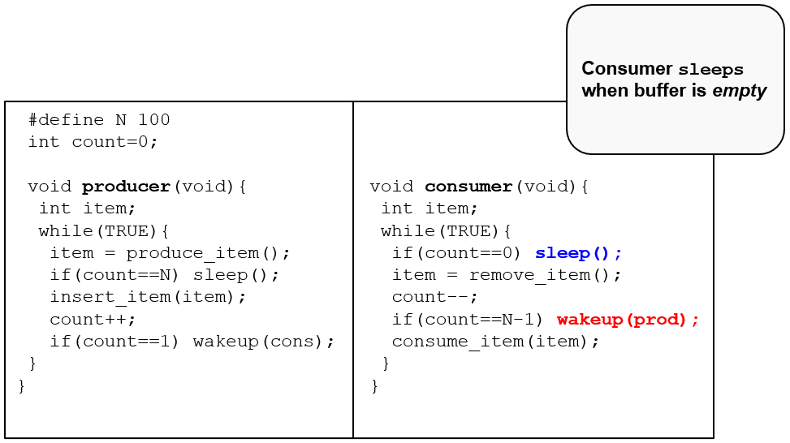
Producer-Consumer (3 of 4)
Notes:
Long Description:
The code from top to bottom is as follows.
hashtag define N 100
int count equals 0 semicolon
void producer left parenthesis void right parenthesis left brace
int item semicolon
while left parenthesis TRUE right parenthesis left
item equals produce underscore item left parenthesis right parenthesis semicolon
if left parenthesis count equals equals N right parenthesis sleep left parenthesis right parenthesis semicolon
insert underscore item left parenthesis item right parenthesis semicolon
count plus plus semicolon
if left parenthesis count equals equals 1 right parenthesis wakeup left parenthesis cons right parenthesis semicolon
right brace
right brace
void consumer left parenthesis void right parenthesis left brace
int item semicolon
while left parenthesis TRUE right parenthesis left brace
if left parenthesis count equals equals 0 right parenthesis sleep left parenthesis right parenthesis semicolon
item equals remove underscore item left parenthesis right parenthesis semicolon
count minus minus
if left parenthesis count equals equals N minus 1 right parenthesis wakeup left parenthesis p r o d right parenthesis semicolon
consume underscore item left parenthesis item right parenthesis semicolon
right brace
right brace
A insert below reads consumer sleeps when buffer is empty.

Slide 60
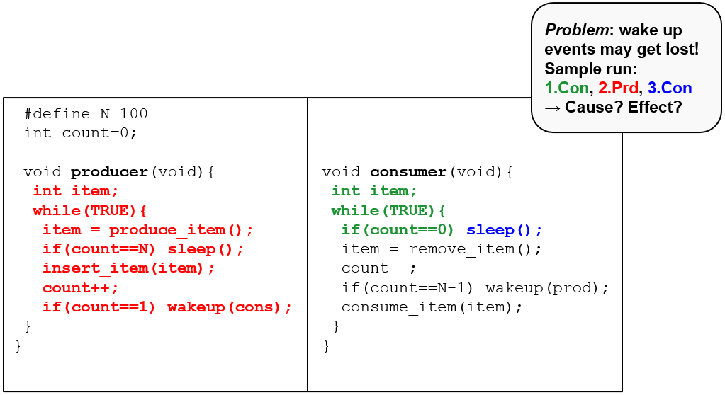
Producer-Consumer (4 of 4)
Notes:
Long Description:
The code from top to bottom is as follows.
hashtag define N 100
int count equals 0 semicolon
void producer left parenthesis void right parenthesis left brace
int item semicolon
while left parenthesis TRUE right parenthesis left
item equals produce underscore item left parenthesis right parenthesis semicolon
if left parenthesis count equals equals N right parenthesis sleep left parenthesis right parenthesis semicolon
insert underscore item left parenthesis item right parenthesis semicolon
count plus plus semicolon
if left parenthesis count equals equals 1 right parenthesis wakeup left parenthesis cons right parenthesis semicolon
right brace
right brace
void consumer left parenthesis void right parenthesis left brace
int item semicolon
while left parenthesis TRUE right parenthesis left brace
if left parenthesis count equals equals 0 right parenthesis sleep left parenthesis right parenthesis semicolon
item equals remove underscore item left parenthesis right parenthesis semicolon
count minus minus
if left parenthesis count equals equals N minus 1 right parenthesis wakeup left parenthesis p r o d right parenthesis semicolon
consume underscore item left parenthesis item right parenthesis semicolon
right brace
right brace
A insert below reads problem colon wake up events may get lost exclamation mark Sample run colon 1 dot con comma 2 dot P r d comma 3 dot C o n right arrow cause question mark effect question mark.

Slide 61
Semaphores
Idea: introduce a special sema integer type with 2 operations:
down:
If sema
then block the calling process
sema=sema-1 otherwise
up:
if there is a process blocking on sema, wake it up
sema=sema+1 otherwise
O S guarantees all the operations are atomic by design
Disable interrupts on single processors
Spin locking on multiprocessors
Back to busy waiting problems?
Uses for binary semaphores (aka mutexes)?

Slide 62
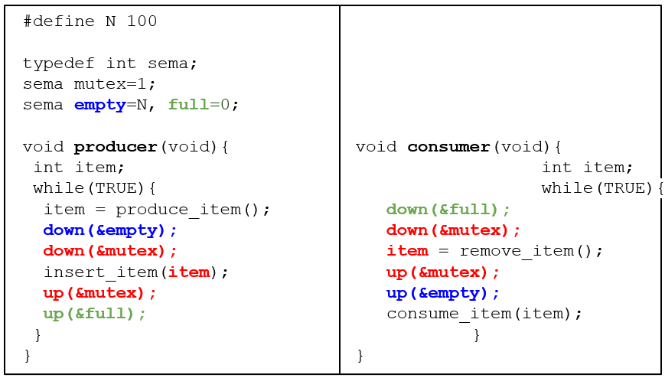
Semaphores: Producer-Consumer (1 of 5)
Notes:
different uses of semaphores:
mutex : for mutual exclusion
empty/full: for synchronization
Long Description:
The code from top to bottom is as follows.
hash define N 100
type def int s e m a
s e m a mutex equals 1 semicolon
s e m a empty equals N comma full equals 0 semicolon
void producer left parenthesis void right parenthesis left brace
int item semicolon
while left parenthesis TRUE right parenthesis left brace
item equals produce underscore item left parenthesis right parenthesis semicolon
down left parenthesis ampersand empty right parenthesis semicolon
down left parenthesis ampersand mutex right parenthesis semicolon
insert underscore item left parenthesis item right parenthesis semicolon
up left parenthesis ampersand mutex right parenthesis semicolon
up left parenthesis ampersand full right parenthesis semicolon
right brace
right brace
void consumer left parenthesis void right parenthesis left brace
int item semicolon
while left parenthesis TRUE right parenthesis left brace
down left parenthesis ampersand full right parenthesis semicolon
down left parenthesis ampersand mutex right parenthesis semicolon
item equals remove underscore item left parenthesis right parenthesis semicolon
up left parenthesis ampersand mutex right parenthesis semicolon
up left parenthesis ampersand empty right parenthesis semicolon
consume underscore item left parenthesis item
right brace
right brace

Slide 63
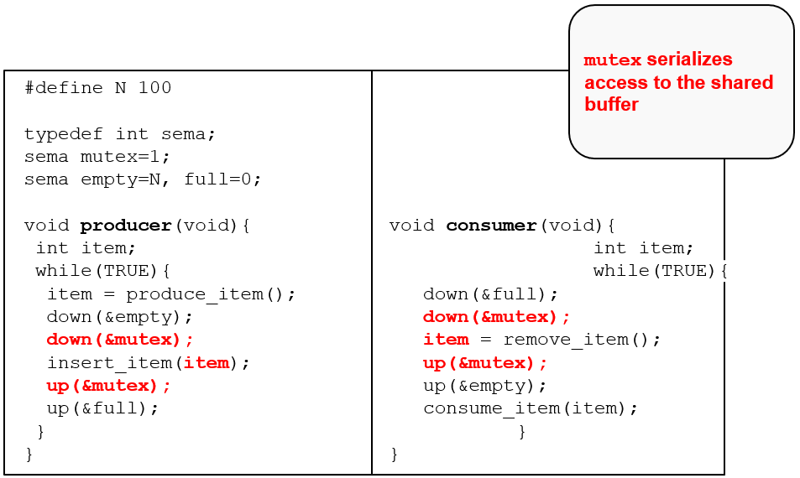
Semaphores: Producer-Consumer (2 of 5)
Notes:
Long Description:
The code from top to bottom is as follows.
hash define N 100
type def int s e m a
s e m a mutex equals 1 semicolon
s e m a empty equals N comma full equals 0 semicolon
void producer left parenthesis void right parenthesis left brace
int item semicolon
while left parenthesis TRUE right parenthesis left brace
item equals produce underscore item left parenthesis right parenthesis semicolon
down left parenthesis ampersand empty right parenthesis semicolon
down left parenthesis ampersand mutex right parenthesis semicolon
insert underscore item left parenthesis item right parenthesis semicolon
up left parenthesis ampersand mutex right parenthesis semicolon
up left parenthesis ampersand full right parenthesis semicolon
right brace
right brace
void consumer left parenthesis void right parenthesis left brace
int item semicolon
while left parenthesis TRUE right parenthesis left brace
down left parenthesis ampersand full right parenthesis semicolon
down left parenthesis ampersand mutex right parenthesis semicolon
item equals remove underscore item left parenthesis right parenthesis semicolon
up left parenthesis ampersand mutex right parenthesis semicolon
up left parenthesis ampersand empty right parenthesis semicolon
consume underscore item left parenthesis item
right brace
right brace
An insert on the top right reads mutex serializes access to the shared buffer.

Slide 64
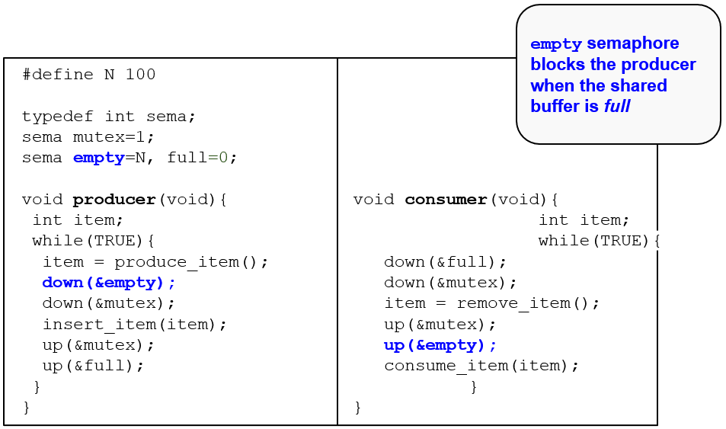
Semaphores: Producer-Consumer (3 of 5)
Notes:
Long Description:
The code from top to bottom is as follows.
hash define N 100
type def int s e m a
s e m a mutex equals 1 semicolon
s e m a empty equals N comma full equals 0 semicolon
void producer left parenthesis void right parenthesis left brace
int item semicolon
while left parenthesis TRUE right parenthesis left brace
item equals produce underscore item left parenthesis right parenthesis semicolon
down left parenthesis ampersand empty right parenthesis semicolon
down left parenthesis ampersand mutex right parenthesis semicolon
insert underscore item left parenthesis item right parenthesis semicolon
up left parenthesis ampersand mutex right parenthesis semicolon
up left parenthesis ampersand full right parenthesis semicolon
right brace
right brace
void consumer left parenthesis void right parenthesis left brace
int item semicolon
while left parenthesis TRUE right parenthesis left brace
down left parenthesis ampersand full right parenthesis semicolon
down left parenthesis ampersand mutex right parenthesis semicolon
item equals remove underscore item left parenthesis right parenthesis semicolon
up left parenthesis ampersand mutex right parenthesis semicolon
up left parenthesis ampersand empty right parenthesis semicolon
consume underscore item left parenthesis item
right brace
right brace
An insert on the top right reads empty semaphore blocks the producer when the shared buffer is full.

Slide 65
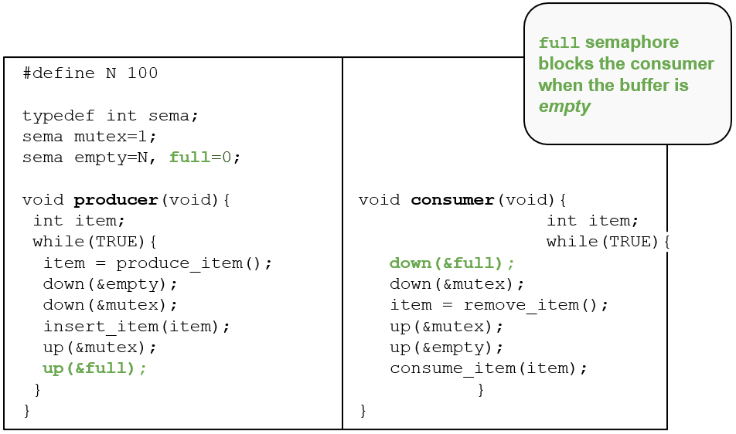
Semaphores: Producer-Consumer (4 of 5)
Notes:
Long Description:
The code from top to bottom is as follows.
hash define N 100
type def int s e m a
s e m a mutex equals 1 semicolon
s e m a empty equals N comma full equals 0 semicolon
void producer left parenthesis void right parenthesis left brace
int item semicolon
while left parenthesis TRUE right parenthesis left brace
item equals produce underscore item left parenthesis right parenthesis semicolon
down left parenthesis ampersand empty right parenthesis semicolon
down left parenthesis ampersand mutex right parenthesis semicolon
insert underscore item left parenthesis item right parenthesis semicolon
up left parenthesis ampersand mutex right parenthesis semicolon
up left parenthesis ampersand full right parenthesis semicolon
right brace
right brace
void consumer left parenthesis void right parenthesis left brace
int item semicolon
while left parenthesis TRUE right parenthesis left brace
down left parenthesis ampersand full right parenthesis semicolon
down left parenthesis ampersand mutex right parenthesis semicolon
item equals remove underscore item left parenthesis right parenthesis semicolon
up left parenthesis ampersand mutex right parenthesis semicolon
up left parenthesis ampersand empty right parenthesis semicolon
consume underscore item left parenthesis item
right brace
right brace
An insert on the top right reads full semaphore blocks the consumer when the buffer is empty.

Slide 66
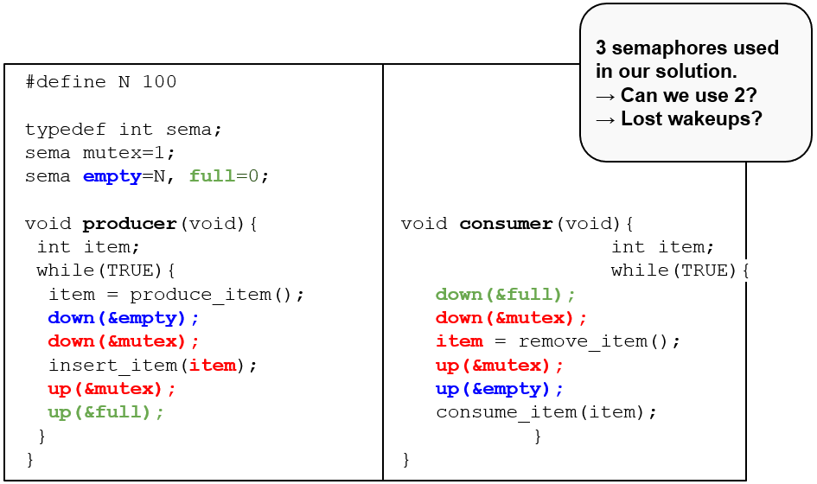
Semaphores: Producer-Consumer (5 of 5)
Notes:
Long Description:
The code from top to bottom is as follows.
hash define N 100
type def int s e m a
s e m a mutex equals 1 semicolon
s e m a empty equals N comma full equals 0 semicolon
void producer left parenthesis void right parenthesis left brace
int item semicolon
while left parenthesis TRUE right parenthesis left brace
item equals produce underscore item left parenthesis right parenthesis semicolon
down left parenthesis ampersand empty right parenthesis semicolon
down left parenthesis ampersand mutex right parenthesis semicolon
insert underscore item left parenthesis item right parenthesis semicolon
up left parenthesis ampersand mutex right parenthesis semicolon
up left parenthesis ampersand full right parenthesis semicolon
right brace
right brace
void consumer left parenthesis void right parenthesis left brace
int item semicolon
while left parenthesis TRUE right parenthesis left brace
down left parenthesis ampersand full right parenthesis semicolon
down left parenthesis ampersand mutex right parenthesis semicolon
item equals remove underscore item left parenthesis right parenthesis semicolon
up left parenthesis ampersand mutex right parenthesis semicolon
up left parenthesis ampersand empty right parenthesis semicolon
consume underscore item left parenthesis item
right brace
right brace
An insert on the top right reads 3 semaphores uses in our solution. Right arrow can we use 2 question mark. Right arrow lost wakeups question mark.

Slide 67
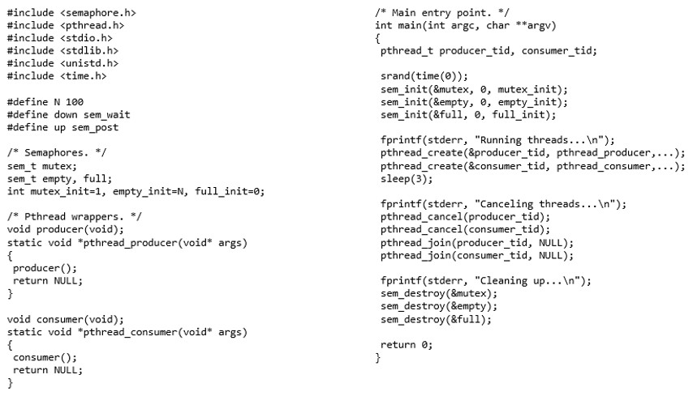
Full Example on Linux
Notes:
Long Description:
The code is as follows: hash include open angle bracket semaphore dot h close angle bracket; hash include open angle bracket pthread dot h close angle bracket; hash include open angle bracket s t d i o dot h close angle bracket; hash include open angle bracket s t d lib dot h close angle bracket; hash include open angle bracket uni s t d dot h close angle bracket; hash include open angle bracket time dot h close angle bracket; hash define N 100; hash define down sem underscore wait; hash define up sem underscore post; front slash asterisk Semaphores dot Asterisk front slash; sem underscore t mutex semicolon; sem underscore t empty, full semicolon; int mutex underscore init equals 1, empty underscore init equals N, full underscore init equals 0 semicolon; front slash asterisk Pthread wrappers dot Asterisk front slash; void producer open round bracket void close round bracket semicolon; static void asterisk pthread underscore producer open round bracket void asterisk args close round bracket; open curly bracket; producer open round bracket close round bracket semicolon; return NULL semicolon; close curly bracket; void consumer open round bracket void close round bracket semicolon; static void asterisk pthread underscore consumer open round bracket void asterisk args close round bracket; open curly bracket; consumer open round bracket close round bracket semicolon; return NULL semicolon; close curly bracket; forward slash asterisk Main entry point. Asterisk forward slash; int main open round bracket int arg c comma char asterisk asterisk arg v close round bracket; open curly bracket; pthread underscore t producer underscore tid comma consumer underscore tid semicolon; srand open round bracket time open round bracket 0 close round bracket close round bracket semicolon; sem underscore init open round bracket ampersand mutex comma 0 comma mutex underscore init close round bracket semicolon; sem underscore init open round bracket ampersand empty comma 0 comma empty underscore init close round bracket semicolon; sem underscore init open round bracket ampersand full comma 0 comma full underscore init close round bracket semicolon; f print f open round bracket stderr comma open quote Running threads ellipsis forward slash n close quote close round bracket semicolon; pthread underscore create open round bracket ampersand producer underscore tid comma pthread underscore producer comma ellipsis close round bracket semicolon; pthread underscore create open round bracket ampersand consumer underscore tid comma pthread underscore consumer comma ellipsis close round bracket semicolon; sleep open round bracket 3 close round bracket semicolon; f print f open round bracket stderr comma open quote Canceling threads ellipsis forward slash n close quote close round bracket semicolon; pthread underscore cancel open round bracket producer underscore tid close round bracket semicolon; pthread underscore cancel open round bracket consumer underscore tid close round bracket semicolon; pthread underscore join open round bracket producer underscore tid comma NULL close round bracket semicolon; pthread underscore join open round bracket consumer underscore tid comma NULL close round bracket semicolon; f print f open round bracket stderr comma close quote Cleaning up ellipsis forward slash n close quote close round bracket semicolon; sem underscore destroy open round bracket ampersand mutex close round bracket semicolon; sem underscore destroy open round bracket ampersand empty close round bracket semicolon; sem underscore destroy open round bracket ampersand full close round bracket semicolon; return 0 semicolon; close curly bracket.

Slide 68
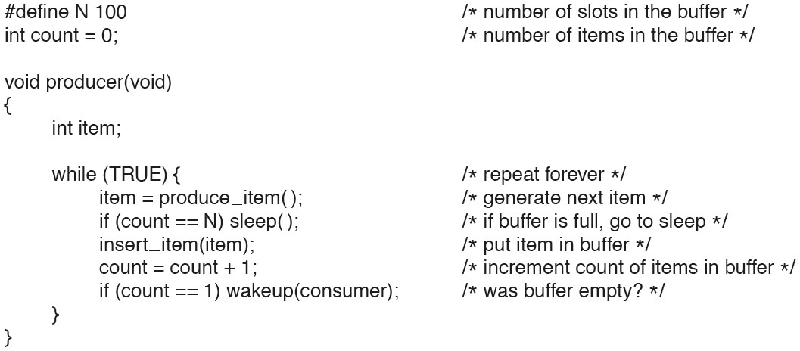
Semaphores (1)
Figure 2.28. The producer-consumer problem using semaphores.
Notes:
Long Description:
hashtag define N 100 forward slash asterisk number of slots in the buffer asterisk forward slash
type d e f int semaphore semicolon forward slash asterisk semaphores are a special kind of int asterisk forward slash
semaphore mutex equals 1 semicolon forward slash asterisk controls access to critical region asterisk forward slash
semaphore empty equals N semicolon forward slash asterisk counts empty buffer slots asterisk forward slash
semaphore full equals 0 semicolon forward slash asterisk counts full buffer slots asterisk forward slash
void producer left parenthesis void right parenthesis
left brace
int item semicolon
while left parenthesis TRUE right parenthesis left brace forward slash asterisk TRUE is the constant 1 asterisk forward slash
item equals produce underscore item left right parenthesis semicolon forward slash asterisk generate something to put in buffer asterisk forward slash
down left parenthesis ampersand empty right parenthesis semicolon forward slash asterisk decrement empty count asterisk forward slash
down left parenthesis ampersand mutex right parenthesis semicolon forward slash asterisk enter critical region asterisk forward slash
insert underscore item left parenthesis item right parenthesis semicolon forward slash asterisk put new item in buffer asterisk forward slash
up left parenthesis ampersand mutex right parenthesis semicolon forward slash asterisk leave critical region asterisk forward slash
up left parenthesis ampersand full right parenthesis semicolon forward slash asterisk increment count of full slots asterisk forward slash
right brace
right brace

Slide 69
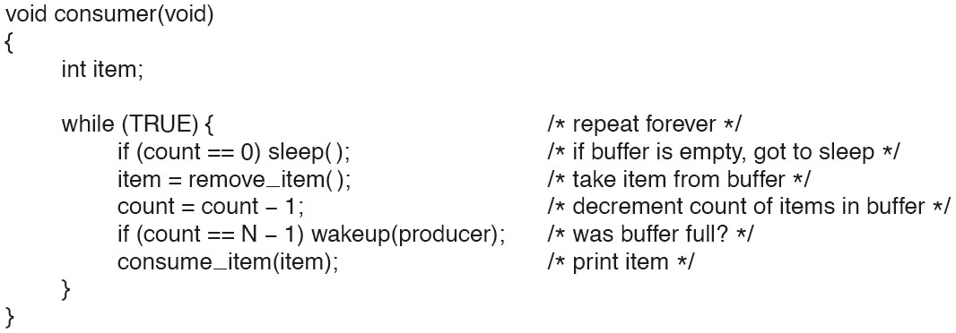
Semaphores (2)
Figure 2.28. The producer-consumer problem using semaphores.
Notes:
Long Description:
The code from top to bottom is as follows.
void consumer left parenthesis void right parenthesis
left brace
int item semicolon
while left parenthesis TRUE right parenthesis left brace forward slash asterisk infinite loop asterisk forward slash
down left parenthesis ampersand full right parenthesis semicolon forward slash asterisk decrement full count asterisk forward slash
down left parenthesis ampersand mutex right parenthesis semicolon forward slash asterisk enter critical region asterisk forward slash
item equals remove underscore item left parenthesis right parenthesis semicolon forward slash asterisk take item from buffer asterisk forward slash
up left parenthesis ampersand mutex right parenthesis semicolon forward slash asterisk leave critical region asterisk forward slash
up left parenthesis ampersand empty right parenthesis semicolon forward slash asterisk increment count of empty slots asterisk forward slash
consume underscore item left parenthesis item right parenthesis semicolon forward slash asterisk do something with the item asterisk forward slash
right brace
right brace

Slide 70
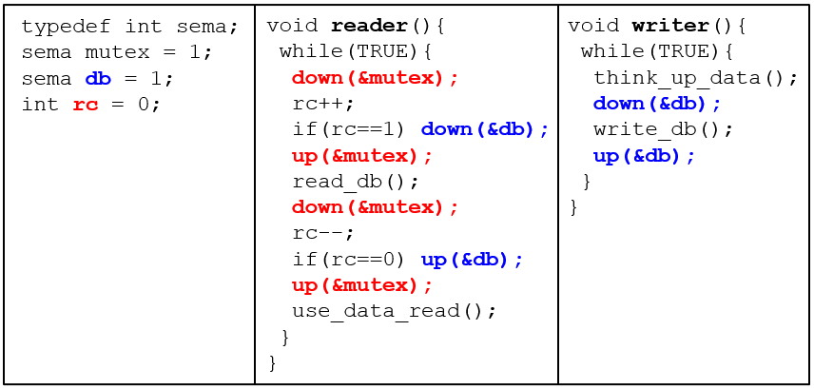
Readers/Writers (1 of 6)
N processes access (i.e., read or write) some shared data
At any given time: R readers or 1 writer allowed. Basic solution:
Notes:
Long Description:
The code from top to bottom is as follows.
type def int sema semicolon
sema mutex equals 1 semicolon
semaphore d b equals 1 semicolon
int r c equals 0 semicolon
void reader left parenthesis void right parenthesis left brace
while left parenthesis TRUE right parenthesis left brace
down left parenthesis ampersand mutex right parenthesis semicolon
r c plus plus semicolon
if left parenthesis r c equals equals 1 right parenthesis down left parenthesis ampersand d b right parenthesis semicolon
up left parenthesis ampersand mutex right parenthesis semicolon
read underscore data underscore base left parenthesis right parenthesis semicolon
down left parenthesis ampersand mutex right parenthesis semicolon
r c minus minus semicolon
if left parenthesis r c equals equals 0 right parenthesis up left parenthesis ampersand d b right parenthesis semicolon
up left parenthesis ampersand mutex right parenthesis semicolon
use underscore data underscore read left parenthesis right parenthesis semicolon
right brace
right brace
void writer left parenthesis right parenthesis
left brace
while left parenthesis TRUE right parenthesis left brace
think underscore up underscore data left right parenthesis semicolon
down left parenthesis ampersand d b right parenthesis semicolon
write underscore d b left parenthesis right parenthesis semicolon
up left parenthesis ampersand d b right parenthesis semicolon forward slash asterisk release exclusive access asterisk forward slash
right brace
right brace

Slide 71
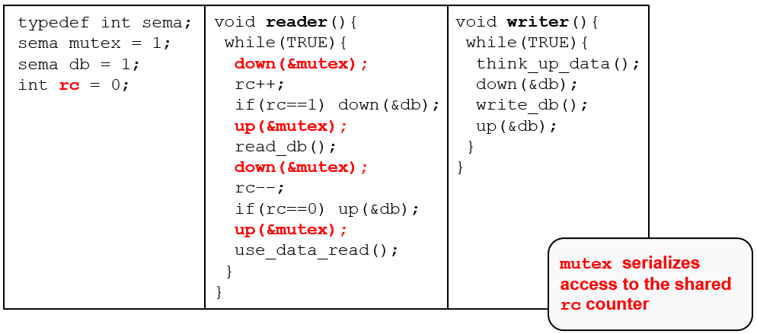
Readers/Writers (2 of 6)
N processes access (i.e., read or write) some shared data
At any given time: R readers or 1 writer allowed. Basic solution:
Notes:
Long Description:
The code from top to bottom is as follows.
type def int sema semicolon
sema mutex equals 1 semicolon
semaphore d b equals 1 semicolon
int r c equals 0 semicolon
void reader left parenthesis void right parenthesis left brace
while left parenthesis TRUE right parenthesis left brace
down left parenthesis ampersand mutex right parenthesis semicolon
r c plus plus semicolon
if left parenthesis r c equals equals 1 right parenthesis down left parenthesis ampersand d b right parenthesis semicolon
up left parenthesis ampersand mutex right parenthesis semicolon
read underscore data underscore base left parenthesis right parenthesis semicolon
down left parenthesis ampersand mutex right parenthesis semicolon
r c minus minus semicolon
if left parenthesis r c equals equals 0 right parenthesis up left parenthesis ampersand d b right parenthesis semicolon
up left parenthesis ampersand mutex right parenthesis semicolon
use underscore data underscore read left parenthesis right parenthesis semicolon
right brace
right brace
void writer left parenthesis right parenthesis
left brace
while left parenthesis TRUE right parenthesis left brace
think underscore up underscore data left right parenthesis semicolon
down left parenthesis ampersand d b right parenthesis semicolon
write underscore d b left parenthesis right parenthesis semicolon
up left parenthesis ampersand d b right parenthesis semicolon forward slash asterisk release exclusive access asterisk forward slash
right brace
right brace
An insert on the bottom right reads mutex serializes access to the shared r cd counter.

Slide 72
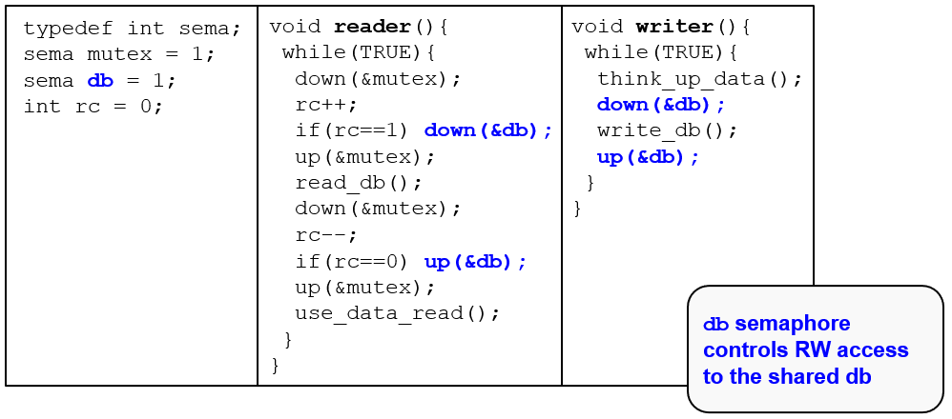
Readers/Writers (3 of 6)
N processes access (i.e., read or write) some shared data
At any given time: R readers or 1 writer allowed. Basic solution:
Notes:
Long Description:
The code from top to bottom is as follows.
type def int sema semicolon
sema mutex equals 1 semicolon
semaphore d b equals 1 semicolon
int r c equals 0 semicolon
void reader left parenthesis void right parenthesis left brace
while left parenthesis TRUE right parenthesis left brace
down left parenthesis ampersand mutex right parenthesis semicolon
r c plus plus semicolon
if left parenthesis r c equals equals 1 right parenthesis down left parenthesis ampersand d b right parenthesis semicolon
up left parenthesis ampersand mutex right parenthesis semicolon
read underscore data underscore base left parenthesis right parenthesis semicolon
down left parenthesis ampersand mutex right parenthesis semicolon
r c minus minus semicolon
if left parenthesis r c equals equals 0 right parenthesis up left parenthesis ampersand d b right parenthesis semicolon
up left parenthesis ampersand mutex right parenthesis semicolon
use underscore data underscore read left parenthesis right parenthesis semicolon
right brace
right brace
void writer left parenthesis right parenthesis
left brace
while left parenthesis TRUE right parenthesis left brace
think underscore up underscore data left right parenthesis semicolon
down left parenthesis ampersand d b right parenthesis semicolon
write underscore d b left parenthesis right parenthesis semicolon
up left parenthesis ampersand d b right parenthesis semicolon forward slash asterisk release exclusive access asterisk forward slash
right brace
right brace
An insert on the bottom right reads d b semaphore controls R W access to the shared d b.

Slide 73
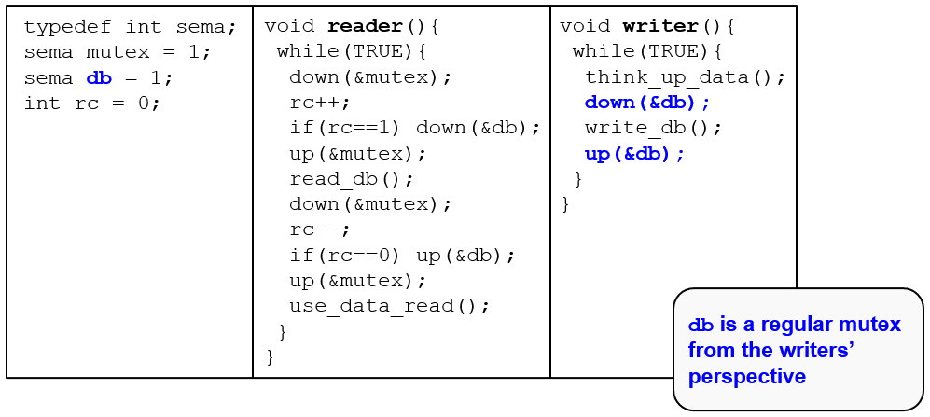
Readers/Writers (4 of 6)
N processes access (i.e., read or write) some shared data
At any given time: R readers or 1 writer allowed. Basic solution:
Notes:
Long Description:
The code from top to bottom is as follows.
type def int sema semicolon
sema mutex equals 1 semicolon
semaphore d b equals 1 semicolon
int r c equals 0 semicolon
void reader left parenthesis void right parenthesis left brace
while left parenthesis TRUE right parenthesis left brace
down left parenthesis ampersand mutex right parenthesis semicolon
r c plus plus semicolon
if left parenthesis r c equals equals 1 right parenthesis down left parenthesis ampersand d b right parenthesis semicolon
up left parenthesis ampersand mutex right parenthesis semicolon
read underscore data underscore base left parenthesis right parenthesis semicolon
down left parenthesis ampersand mutex right parenthesis semicolon
r c minus minus semicolon
if left parenthesis r c equals equals 0 right parenthesis up left parenthesis ampersand d b right parenthesis semicolon
up left parenthesis ampersand mutex right parenthesis semicolon
use underscore data underscore read left parenthesis right parenthesis semicolon
right brace
right brace
void writer left parenthesis right parenthesis
left brace
while left parenthesis TRUE right parenthesis left brace
think underscore up underscore data left right parenthesis semicolon
down left parenthesis ampersand d b right parenthesis semicolon
write underscore d b left parenthesis right parenthesis semicolon
up left parenthesis ampersand d b right parenthesis semicolon forward slash asterisk release exclusive access asterisk forward slash
right brace
right brace
An insert on the bottom right reads d b is a regular mutex from the writers' perspective.

Slide 74
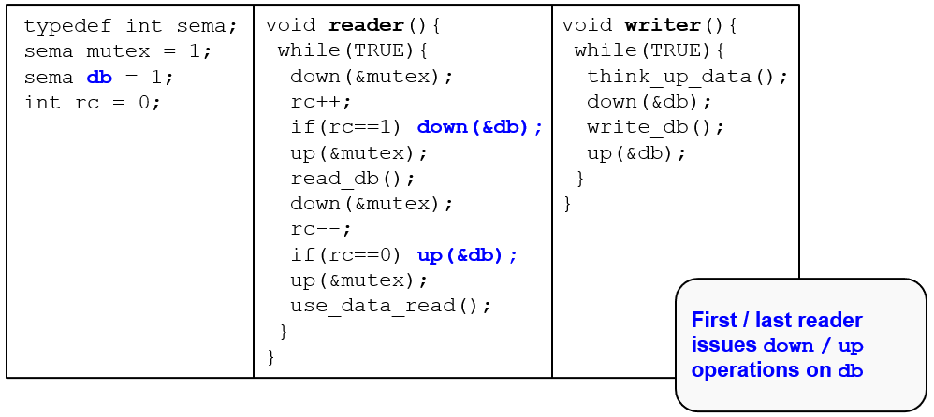
Readers/Writers (5 of 6)
N processes access (i.e., read or write) some shared data
At any given time: R readers or 1 writer allowed. Basic solution:
Notes:
Long Description:
The code from top to bottom is as follows.
type def int sema semicolon
sema mutex equals 1 semicolon
semaphore d b equals 1 semicolon
int r c equals 0 semicolon
void reader left parenthesis void right parenthesis left brace
while left parenthesis TRUE right parenthesis left brace
down left parenthesis ampersand mutex right parenthesis semicolon
r c plus plus semicolon
if left parenthesis r c equals equals 1 right parenthesis down left parenthesis ampersand d b right parenthesis semicolon
up left parenthesis ampersand mutex right parenthesis semicolon
read underscore data underscore base left parenthesis right parenthesis semicolon
down left parenthesis ampersand mutex right parenthesis semicolon
r c minus minus semicolon
if left parenthesis r c equals equals 0 right parenthesis up left parenthesis ampersand d b right parenthesis semicolon
up left parenthesis ampersand mutex right parenthesis semicolon
use underscore data underscore read left parenthesis right parenthesis semicolon
right brace
right brace
void writer left parenthesis right parenthesis
left brace
while left parenthesis TRUE right parenthesis left brace
think underscore up underscore data left right parenthesis semicolon
down left parenthesis ampersand d b right parenthesis semicolon
write underscore d b left parenthesis right parenthesis semicolon
up left parenthesis ampersand d b right parenthesis semicolon forward slash asterisk release exclusive access asterisk forward slash
right brace
right brace
An insert on the bottom right reads first slash last reader issues down slash uop operations on d b.

Slide 75
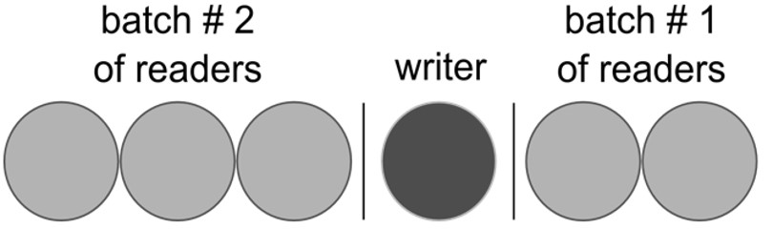
Readers/Writers (6 of 6)
Idea: Build a queue of readers and writers
Let several readers in at the same time
Allow 1 writer when no readers are active
How long may the writer have to wait?
Notes:
Long Description:
The circles are divided into groups of three, one, and two by vertical bars. The first three circles are labeled batch hashtag 2 of readers. The fourth circle is labeled the writer. The last two are labeled as the batch hashtag 1 of readers.

Slide 76
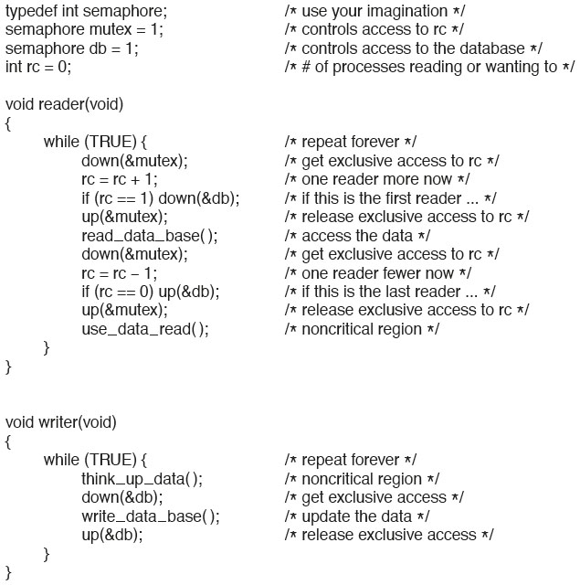
The Readers and Writers Problem
Figure 2.29. A solution to the readers and writers problem.
Notes:
Long Description:
typedef int semaphore semicolon forward slash asterisk use your imagination asterisk forward slash
semaphore mutex equals 1 semicolon forward slash asterisk controls access to rc asterisk forward slash
semaphore db equals 1 semicolon forward slash asterisk controls access to the database asterisk forward slash
int rc equals 0 semicolon forward slash asterisk hash of processes reading or wanting to asterisk forward slash
void reader open parenthesis void close parenthesis
while open parenthesis TRUE close parenthesis open curly bracket forward slash asterisk repeat forever asterisk forward slash
down open parenthesis ampersand mutex close parenthesis semicolon forward slash asterisk get exclusive access to rc asterisk forward slash
rc equals rc plus 1 semicolon forward slash asterisk one reader more now asterisk forward slash
if open parenthesis rc equals equals 1 close parenthesis down open parenthesis ampersand db close parenthesis semicolon forward slash asterisk if this is the first reader ... asterisk forward slash
up open parenthesis ampersand mutex close parenthesis semicolon forward slash asterisk release exclusive access to rc asterisk forward slash
read underscore data underscore base open parenthesis close parenthesis semicolon forward slash asterisk access the data asterisk forward slash
down open parenthesis ampersand mutex close parenthesis semicolon forward slash asterisk get exclusive access to rc asterisk forward slash
rc equals rc minus 1 semicolon forward slash asterisk one reader fewer now asterisk forward slash
if open parenthesis rc equals equals 0 close parenthesis up open parenthesis ampersand db close parenthesis semicolon forward slash asterisk if this is the last reader ... asterisk forward slash
up open parenthesis ampersand mutex close parenthesis semicolon forward slash asterisk release exclusive access to rc asterisk forward slash
use underscore data underscore read open close parenthesis semicolon forward slash asterisk noncritical region asterisk forward slash
void writer open parenthesis void close parenthesis
open curly bracket
while open parenthesis TRUE close parenthesis open curly bracket forward slash asterisk repeat forever asterisk forward slash
think underscore up underscore data open close parenthesis semicolon forward slash asterisk noncritical region asterisk forward slash
down open parenthesis ampersand db close parenthesis semicolon forward slash asterisk get exclusive access asterisk forward slash
write underscore data underscore base open close parenthesis semicolon forward slash asterisk update the data asterisk forward slash
up open parenthesis ampersand db close parenthesis semicolon forward slash asterisk release exclusive access asterisk forward slash
close curly bracket
close curly bracket

Slide 77
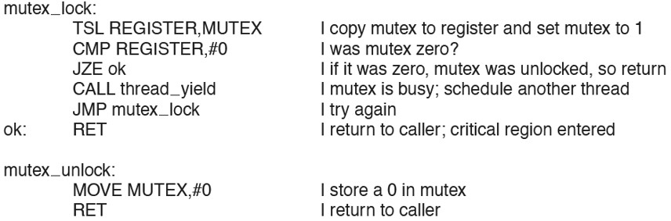
Mutexes: Simple Implementation
Figure 2.30 Implementation of mutex_lock and mutex_unlock.
Notes:
Long Description:
mutex underscore lock colon
TSL REGISTER coma MUTEX vertical line copy mutex to register and set mutex to 1
CMP REGISTER coma hash 0 vertical line was mutex zero question mark
JZE ok vertical line if it was zero coma mutex was unlocked coma so return
CALL thread underscore yield vertical line mutex is busy semicolon schedule another thread
JMP mutex underscore lock vertical line try again
ok colon RET vertical line return to caller semicolon critical region entered
mutex underscore unlock colon
MOVE MUTEX coma hash 0 vertical line store a 0 in mutex
RET vertical line return to caller

Slide 78
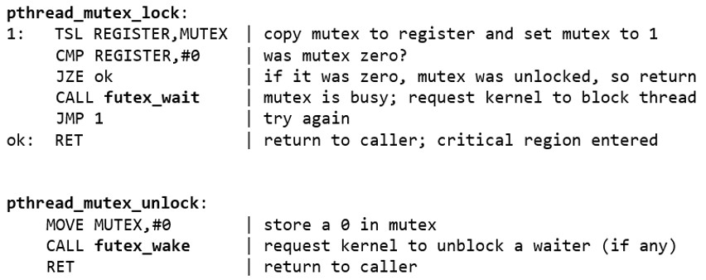
(Extra material) Pthread Mutexes: Linux-style implementation
Notes:
Long Description:
The code from top to bottom is as follows.
p thread underscore mutex underscore lock colon
T S L REGISTER comma MUTEX vertical bar copy mutex to register and set mutex to 1
C M P REGISTER comma hashtag 0 vertical bar was mutex zero question mark
J Z E ok vertical bar if it was zero comma mutex was unlocked comma so return
CALL futex underscore wait vertical bar mutex is busy semicolon request kernel to block thread
J M P 1 vertical bar try again
ok colon RET vertical bar return to caller semicolon critical region entered
p thread underscore mutex underscore unlock colon
MOVE MUTEX coma hashtag 0 vertical bar store a 0 in mutex
CALL futex underscore wait vertical bar request kernel to unblock a waiter left parenthesis if any right parenthesis
RET vertical bar return to caller

Slide 79
Mutexes in Pthreads (1)
Thread Call | Description
pthread_mutex_init | Create a mutex
pthread_mutex_destroy | Destroy an existing mutex
pthread _mutex_lock | Acquire a lock or block
pthread_mutex_trylock | Acquire a lock or fail
pthread_mutex_unlock | Release a lock
Figure 2.31 Some of the Pthreads calls relating to mutexes.

Slide 80
Mutexes in Pthreads (2)
Thread Call | Description
pthread_cond_init | Create a condition variable
pthread_cond_destroy | Destroy a condition variable
pthread _cond_wait | Block waiting for a signal
pthread_cond_signal | Signal another thread and wake it up
pthread_cond_broadcast | Signal multiple threads and wake all of them
Figure 2.32 Some of the Pthreads calls relating to condition variables.

Slide 81
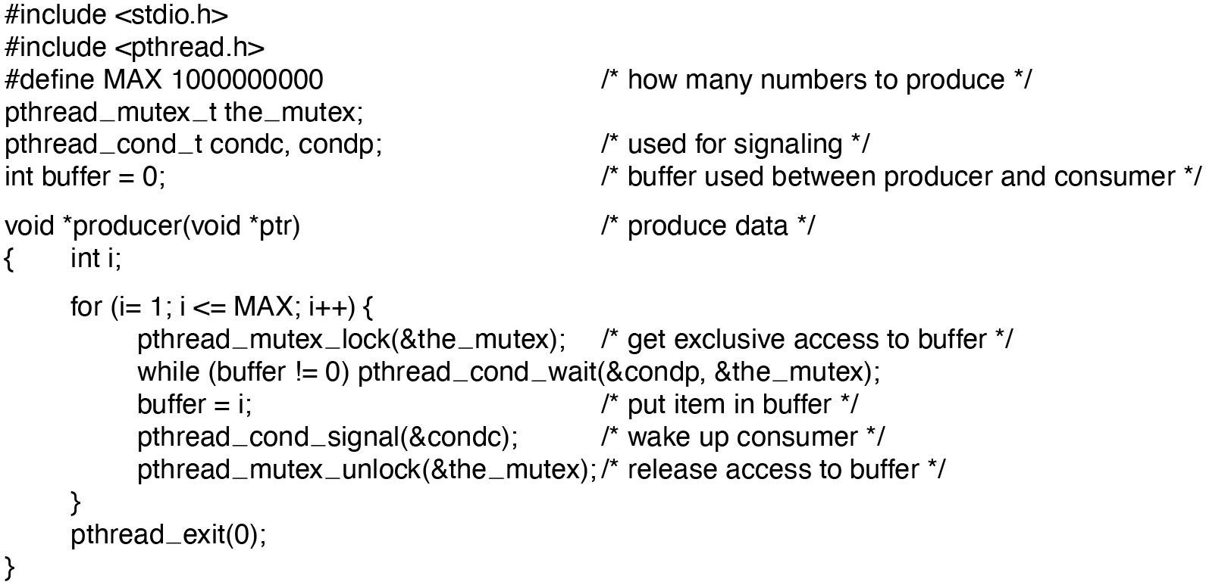
Mutexes in Pthreads (3)
Figure 2.33 Using threads to solve the producer-consumer problem.
Notes:
Long Description:
The code from top to bottom is as follows.
hashtag include left angle bracket s t d i o dot h right angle bracket
hashtag include left angle bracket p thread dot h right angle bracket
hashtag define MAX 1000000000 forward slash asterisk how many numbers to produce asterisk forward slash
p thread underscore mutex underscore t the underscore mutex semicolon
p thread underscore c o n d underscore t c o n d c comma c o n d p semicolon forward slash asterisk used for signaling asterisk forward slash
i n t buffer equals 0 semicolon forward slash asterisk buffer used between producer and consumer asterisk forward slash
void asterisk producer left parenthesis void asterisk p t r right parenthesis forward slash asterisk produce data asterisk forward slash
left brace int i semi colon
for left parenthesis i equals 1 semicolon i less than equals to MAX semicolon i plus plus right parenthesis left brace
p thread underscore mutex underscore lock left parenthesis ampersand the underscore mutex right parenthesis semicolon forward slash asterisk get exclusive access to buffer asterisk forward slash
while left parenthesis buffer exclamation mark equals to 0 right parenthesis p thread underscore cond under score wait left parenthesis &condp coma &the underscore mutex right parenthesis semi colon
buffer equals to i semi colon forward slash asterisk put item in buffer asterisk forward slash
p thread under score c o n d underscore signal left parenthesis ampersand c o n d c right parenthesis semicolon forward slash asterisk wake up consumer asterisk forward slash
p thread underscore mutex underscore unlock left parenthesis ampersand the underscore mutex right parenthesis semi colon forward slash asterisk release access to buffer asterisk forward slash
right brace
p thread underscore exit left parenthesis 0 right parenthesis semicolon
right brace

Slide 82

Mutexes in Pthreads (4)
Figure 2.33 Using threads to solve the producer-consumer problem. (continued)
Notes:
Long Description:
The code from top to bottom is as follows.
void asterisk producer left parenthesis void asterisk p t r right parenthesis forward slash asterisk produce data asterisk forward slash
left brace int i semi colon
for left parenthesis i equals 1 semicolon i less than equals to MAX semicolon i plus plus right parenthesis left brace
p thread underscore mutex underscore lock left parenthesis ampersand the underscore mutex right parenthesis semicolon forward slash asterisk get exclusive access to buffer asterisk forward slash
while left parenthesis buffer exclamation mark equals to 0 right parenthesis p thread underscore cond under score wait left parenthesis ampersand c o n d p comma ampersand the underscore mutex right parenthesis semi colon
buffer equals to i semi colon forward slash asterisk put item in buffer asterisk forward slash
p thread under score c o n d underscore signal left parenthesis ampersand c o n d c right parenthesis semicolon forward slash asterisk wake up consumer asterisk forward slash
p thread underscore mutex underscore unlock left parenthesis ampersand the underscore mutex right parenthesis semi colon forward slash asterisk release access to buffer asterisk forward slash
right brace
p thread underscore exit left parenthesis 0 right parenthesis semicolon
right brace

Slide 83

Mutexes in Pthreads (5)
Figure 2.33 Using threads to solve the producer-consumer problem. (continued)
Notes:
Long Description:
The code from top to bottom is as follows.
int main left parenthesis i n t a r g c comma char asterisk asterisk a r g v right parenthesis
left brace
p thread underscore t pro comma con semi colon
pthread under score mutex underscore init left parenthesis ampersand the underscore mutex comma 0 right parenthesis semicolon
p thread underscore cond underscore init left parenthesis ampersand c o n d c comma 0 right parenthesis semicolon
p thread underscore c o n d under score init left parenthesis ampersand c o n d p comma 0 right parenthesis semicolon
p thread underscore create left parenthesis ampersand con comma 0 comma consumer comma 0 right parenthesis semicolon
p thread underscore create left parenthesis ampersand pro comma 0 comma producer comma 0 right parenthesis semicolon
p thread under score join left parenthesis pro comma 0 right parenthesis semicolon
p thread underscore join left parenthesis con comma 0 right parenthesis semicolon
p thread under score cond under score destroy left parenthesis ampersand c o n d c right parenthesis semicolon
p thread under score cond under score destroy left parenthesis ampersand c o n d p right parenthesis semi colon
p thread underscore mutex under score destroy left parenthesis ampersand the underscore mutex right parenthesis semi colon
right brace

Slide 84
Monitors
Semaphores have been heavily criticized for the chaos they can introduce
Monitors: more structured approach towards process synchronization:
Serialize the procedure calls on a given module
Use condition variables to wait / signal processes
Monitors require language support
Popular in managed languages, e.g., Java:
Synchronized methods / blocks
Wait, notify, notifyall primitives

Slide 85

Monitors (1)
Figure 2.34 A monitor.
Notes:
Long Description:
The coding structure for the example monitor ar as follows.
monitor example
integer i semi colon
condition c semi colon
procedure producer open close parenthesis semi colon
.
.
.
end semi colon
procedure consumer open close parenthesis colon
. . .
end semi colon
end monitor semi colon

Slide 86

Monitors: Producer-Consumer (1 of 5)
Notes:
compiler responsible for adding mutex (so less likely to go wrong)
Long Description:
The code from top to bottom is as follows.
monitor ProdCons left brace
condition full, empty semicolon
int count equals 0 semicolon
void enter open parenthesis int item close parenthesis left brace
if right parenthesis count equal equals N right parenthesis wait left parenthesis full right parenthesis semicolon
insert underscore item left parenthesis item right parenthesis semicolon
count plus plus semicolon
if left parenthesis count equals equals 1 right parenthesis signal left parenthesis empty right parenthesis semicolon
right brace
void remove left parenthesis int asterisk item right parenthesis left brace
if left parenthesis count equals equals 0 right parenthesis wait left parenthesis empty right parenthesis semicolon
asterisk item equals remove underscore item left parenthesis right parenthesis semicolon
count minus minus
if left parenthesis count equals equals N minus 1 right parenthesis signal left parenthesis full right parenthesis semicolon
right brace
right brace
void producer left parenthesis right parenthesis left brace
int item semicolon
while left parenthesis TRUE right parenthesis left brace
item equals produce underscore item left parenthesis right parenthesis semicolon
ProdCons dot enter left parenthesis item right parenthesis semicolon
right brace
right brace
void consumer left parenthesis right parenthesis left brace
int item semicolon
while left parenthesis TRUE right parenthesis left brace
ProdCons dot remove left parenthesis ampersand item right parenthesis semicolon
consume underscore item left parenthesis item right parenthesis semicolon
right brace

Slide 87

Monitors: Producer-Consumer (2 of 5)
Notes:
Long Description:
The code from top to bottom is as follows.
monitor ProdCons left brace
condition full, empty semicolon
int count equals 0 semicolon
void enter open parenthesis int item close parenthesis left brace
if right parenthesis count equal equals N right parenthesis wait left parenthesis full right parenthesis semicolon
insert underscore item left parenthesis item right parenthesis semicolon
count plus plus semicolon
if left parenthesis count equals equals 1 right parenthesis signal left parenthesis empty right parenthesis semicolon
right brace
void remove left parenthesis int asterisk item right parenthesis left brace
if left parenthesis count equals equals 0 right parenthesis wait left parenthesis empty right parenthesis semicolon
asterisk item equals remove underscore item left parenthesis right parenthesis semicolon
count minus minus
if left parenthesis count equals equals N minus 1 right parenthesis signal left parenthesis full right parenthesis semicolon
right brace
right brace
void producer left parenthesis right parenthesis left brace
int item semicolon
while left parenthesis TRUE right parenthesis left brace
item equals produce underscore item left parenthesis right parenthesis semicolon
ProdCons dot enter left parenthesis item right parenthesis semicolon
right brace
right brace
void consumer left parenthesis right parenthesis left brace
int item semicolon
while left parenthesis TRUE right parenthesis left brace
ProdCons dot remove left parenthesis ampersand item right parenthesis semicolon
consume underscore item left parenthesis item right parenthesis semicolon
right brace
An excerpt on the top right corner reads access to enter and remove is serialized by the monitor.

Slide 88

Monitors: Producer-Consumer (3 of 5)
Notes:
Long Description:
The code from top to bottom is as follows.
monitor ProdCons left brace
condition full, empty semicolon
int count equals 0 semicolon
void enter open parenthesis int item close parenthesis left brace
if right parenthesis count equal equals N right parenthesis wait left parenthesis full right parenthesis semicolon
insert underscore item left parenthesis item right parenthesis semicolon
count plus plus semicolon
if left parenthesis count equals equals 1 right parenthesis signal left parenthesis empty right parenthesis semicolon
right brace
void remove left parenthesis int asterisk item right parenthesis left brace
if left parenthesis count equals equals 0 right parenthesis wait left parenthesis empty right parenthesis semicolon
asterisk item equals remove underscore item left parenthesis right parenthesis semicolon
count minus minus
if left parenthesis count equals equals N minus 1 right parenthesis signal left parenthesis full right parenthesis semicolon
right brace
right brace
void producer left parenthesis right parenthesis left brace
int item semicolon
while left parenthesis TRUE right parenthesis left brace
item equals produce underscore item left parenthesis right parenthesis semicolon
ProdCons dot enter left parenthesis item right parenthesis semicolon
right brace
right brace
void consumer left parenthesis right parenthesis left brace
int item semicolon
while left parenthesis TRUE right parenthesis left brace
ProdCons dot remove left parenthesis ampersand item right parenthesis semicolon
consume underscore item left parenthesis item right parenthesis semicolon
right brace
An excerpt on the top right corner reads wait suspends caller on a condition variable right arrow motor state question mark.

Slide 89

Monitors: Producer-Consumer (4 of 5)
Notes:
Long Description:
The code from top to bottom is as follows.
monitor ProdCons left brace
condition full, empty semicolon
int count equals 0 semicolon
void enter open parenthesis int item close parenthesis left brace
if right parenthesis count equal equals N right parenthesis wait left parenthesis full right parenthesis semicolon
insert underscore item left parenthesis item right parenthesis semicolon
count plus plus semicolon
if left parenthesis count equals equals 1 right parenthesis signal left parenthesis empty right parenthesis semicolon
right brace
void remove left parenthesis int asterisk item right parenthesis left brace
if left parenthesis count equals equals 0 right parenthesis wait left parenthesis empty right parenthesis semicolon
asterisk item equals remove underscore item left parenthesis right parenthesis semicolon
count minus minus
if left parenthesis count equals equals N minus 1 right parenthesis signal left parenthesis full right parenthesis semicolon
right brace
right brace
void producer left parenthesis right parenthesis left brace
int item semicolon
while left parenthesis TRUE right parenthesis left brace
item equals produce underscore item left parenthesis right parenthesis semicolon
ProdCons dot enter left parenthesis item right parenthesis semicolon
right brace
right brace
void consumer left parenthesis right parenthesis left brace
int item semicolon
while left parenthesis TRUE right parenthesis left brace
ProdCons dot remove left parenthesis ampersand item right parenthesis semicolon
consume underscore item left parenthesis item right parenthesis semicolon
right brace
An excerpt on the top right corner reads signal wakes up one waiter on a condition variable. Right arrow monitor state question mark right arrow lost wakeups question mark.

Slide 90

Monitors: Producer-Consumer (5 of 5)
Notes:
Long Description:
The code from top to bottom is as follows.
monitor ProdCons left brace
condition full, empty semicolon
int count equals 0 semicolon
void enter open parenthesis int item close parenthesis left brace
if right parenthesis count equal equals N right parenthesis wait left parenthesis full right parenthesis semicolon
insert underscore item left parenthesis item right parenthesis semicolon
count plus plus semicolon
if left parenthesis count equals equals 1 right parenthesis signal left parenthesis empty right parenthesis semicolon
right brace
void remove left parenthesis int asterisk item right parenthesis left brace
if left parenthesis count equals equals 0 right parenthesis wait left parenthesis empty right parenthesis semicolon
asterisk item equals remove underscore item left parenthesis right parenthesis semicolon
count minus minus
if left parenthesis count equals equals N minus 1 right parenthesis signal left parenthesis full right parenthesis semicolon
right brace
right brace
void producer left parenthesis right parenthesis left brace
int item semicolon
while left parenthesis TRUE right parenthesis left brace
item equals produce underscore item left parenthesis right parenthesis semicolon
ProdCons dot enter left parenthesis item right parenthesis semicolon
right brace
right brace
void consumer left parenthesis right parenthesis left brace
int item semicolon
while left parenthesis TRUE right parenthesis left brace
ProdCons dot remove left parenthesis ampersand item right parenthesis semicolon
consume underscore item left parenthesis item right parenthesis semicolon
right brace
An excerpt on the top right corner reads monitors make parallel programming much easier right arrow do we need more question mark.

Slide 91

Monitors (2)
Figure 2.35. An outline of the producer-consumer problem with monitors. Only one monitor procedure at a time is active. The buffer has N slots.
Notes:
Long Description:
The code from top to bottom is as follows.
monitor ProducerConsumer
condition full comma empty semi colon
integer count semi colon
procedure insert left parenthesis item colon integer right parenthesis semi colon
begin
if count equals N then wait left parenthesis full right parenthesis semi colon
insert underscore item left parenthesis item right parenthesis semi colon
count colon equals to count plus 1 semicolon
if count equals to 1 then signal left parenthesis empty right parenthesis
end semicolon
function remove colon integer semi colon
begin
if count equals 0 then wait left parenthesis empty right parenthesis semi colon
remove equals remove underscore item semi colon
count colon equals to count minus 1 semicolon
if count equals to N minus 1 then signal left parenthesis full right parenthesis
end semicolon
count colon equals to 0 semicolon
end monitor semi colon

Slide 92

Monitors (3)
Figure 2.35. An outline of the producer-consumer problem with monitors. Only one monitor procedure at a time is active. The buffer has N slots.
Notes:
Long Description:
The code from top to bottom is as follows.
procedure producer semi colon
begin
while true do
begin
item equals to produce underscore item semi colon
ProducerConsumer.insert left parenthesis item right parenthesis
end
end semicolon
procedure consumer semi colon
begin
while true do
begin
item equals to ProducerConsumer dot remove semicolon
consume under score item left parenthesis item right parenthesis
end
end semicolon

Slide 93

Monitors (4)
Figure 2.36. A solution to the producer-consumer problem in Java.
Notes:
Long Description:
The code from top to bottom is as follows.
public class ProducerConsumer left brace
static final int N equals 100 semicolon forward slash forward slash constant giving the buffer size
static producer p equals new producer left parenthesis right parenthesis semicolon forward slash forward slash instantiate a new producer thread
static consumer c equals new consumer left parenthesis right parenthesis semicolon forward slash forward slash instantiate a new consumer thread
static our underscore monitor mon equals to new our underscore monitor left parenthesis right parenthesis semicolon forward slash forward slash instantiate a new monitor
public static void main left parenthesis String a r g s left bracket right bracket right parenthesis left brace
p dot start parenthesis left right parenthesis semicolon forward slash forward slash start the producer thread
c dot start left right parenthesis semicolon forward slash forward slash start the consumer thread
right brace
static class producer extends Thread left brace
public void run left right parenthesis left brace forward slash forward slash run method contains the thread code
int item semicolon
while left parenthesis true right parenthesis left brace forward slash forward slash producer loop
item equals produce underscore item left right parenthesis semicolon
mon dot insert left parenthesis item right parenthesis semicolon
right brace
right brace
private int produce underscore item left right parenthesis left brace triple dot right brace forward slash forward slash actually produce
right brace

Slide 94

Monitors (5)
Figure 2.36. A solution to the producer-consumer problem in Java.
Notes:
Long Description:
The code from top to bottom is as follows.
static class consumer extends Thread left brace
public void run left right parenthesis left brace run method contains the thread code
int item semicolon
while left parenthesis true right parenthesis left brace
forward slash forward slash consumer loop
item equals to mon dot remove left right parenthesis semicolon
consume underscore item left parenthesis item right parenthesis semicolon
right brace
right brace
private void consume underscore item left parenthesis int item right parenthesis left brace triple dot right brace forward slash forward slash actually consume
right brace
static class our underscore monitor left brace forward slash forward slash this is a monitor
private int buffer left right box bracket equals to new int left bracket N right bracket semicolon
private int count equals to 0 coma lo equals to 0 coma hi equals to 0 semicolon forward slash forward slash counters and indices

Slide 95

Monitors (6)
Figure 2.36. A solution to the producer-consumer problem in Java.
Notes:
Long Description:
The code from top to bottom is as follows.
public synchronized void insert left parenthesis int val right parenthesis left brace
if left parenthesis count equals to equals to N right parenthesis go underscore to underscore sleep left right parenthesis semicolon forward slash forward slash if the buffer is full coma go to sleep
buffer left box bracket hiright box bracket equals to val semicolon forward slash forward slash insert an item into the buffer
hi equals to left parenthesis hi plus 1 right parenthesis percent N semicolon forward slash forward slash slot to place next item in
count equals to count plus 1 semicolon forward slash forward slash one more item in the buffer now
if left parenthesis count equals to equals to 1 right parenthesis notify left right parenthesis semicolon forward slash forward slash if consumer was sleeping coma wake it up
right brace
public synchronized int remove left right parenthesis left brace
int val semicolon
if left parenthesis count equals to equals to 0 right parenthesis go underscore to underscore sleep left right parenthesis semicolon forward slash forward slash if the buffer is empty coma go to sleep
val equals to buffer left bracket lo right bracket semicolon forward slash forward slash fetch an item from the buffer
lo equals to left parenthesis lo plus 1 right parenthesis percent N semicolon forward slash forward slash slot to fetch next item from
count equals to count minus 1 semicolon forward slash forward slash one few items in the buffer
if left parenthesis count equals to equals to N minus 1 right parenthesis notify left right parenthesis semicolon forward slash forward slash if producer was sleeping coma wake it up
return val semicolon
right brace
private void go underscore to underscore sleep left parenthesis right parenthesis left brace try left brace wait left parenthesis right parenthesis semicolon right brace catch left parenthesis Interrupted Exception exec right parenthesis left right brace semicolon right brace
right brace
right brace

Slide 96
Message Passing
Solution to both the process synchronization and the process communication problems
Most common choice in multiserver O S designs
Processes interact by sending and receiving messages:
send(destination, &message);
receive(source, &message);
receive(ANY, &message);

Slide 97

Message Passing: Producer-Consumer (1 of 5)
Notes:
Long Description:
The code from top to bottom is as follows.
hashtag define N 100
void producer left parenthesis right parenthesis left brace
int item semicolon
message msg semicolon
while left parenthesis TRUE right parenthesis left brace
item equals produce underscore item left right parenthesis semicolon
receive left parenthesis consumer comma ampersand msg right parenthesis semicolon
build underscore message left parenthesis ampersand msg comma item right parenthesis semicolon
send left parenthesis consumer comma ampersand msg right parenthesis semicolon
right brace
right brace
void consumer left parenthesis right parenthesis left brace
int item comma i semicolon
message msg semicolon
for left parenthesis i equals 0 semicolon i less than N semicolon i plus plus right parenthesis
send left parenthesis producer comma ampersand msg right parenthesis semicolon
while left parenthesis TRUE right parenthesis left brace
receive left parenthesis producer comma ampersand msg right parenthesis semicolon
item equals extract underscore item left parenthesis ampersand msg right parenthesis semicolon
send left parenthesis producer comma ampersand msg right parenthesis semicolon
consume underscore item left parenthesis item right parenthesis semicolon
right brace
right brace

Slide 98

Message Passing: Producer-Consumer (2 of 5)
Notes:
Long Description:
The code from top to bottom is as follows.
hashtag define N 100
void producer left parenthesis right parenthesis left brace
int item semicolon
message msg semicolon
while left parenthesis TRUE right parenthesis left brace
item equals produce underscore item left right parenthesis semicolon
receive left parenthesis consumer comma ampersand msg right parenthesis semicolon
build underscore message left parenthesis ampersand msg comma item right parenthesis semicolon
send left parenthesis consumer comma ampersand msg right parenthesis semicolon
right brace
right brace
void consumer left parenthesis right parenthesis left brace
int item comma i semicolon
message msg semicolon
for left parenthesis i equals 0 semicolon i less than N semicolon i plus plus right parenthesis
send left parenthesis producer comma ampersand msg right parenthesis semicolon
while left parenthesis TRUE right parenthesis left brace
receive left parenthesis producer comma ampersand msg right parenthesis semicolon
item equals extract underscore item left parenthesis ampersand msg right parenthesis semicolon
send left parenthesis producer comma ampersand msg right parenthesis semicolon
consume underscore item left parenthesis item right parenthesis semicolon
right brace
right brace
An insert on the top right corner reads N messages buffered by the system, initially all empty.

Slide 99

Message Passing: Producer-Consumer (3 of 5)
Notes:
Long Description:
The code from top to bottom is as follows.
hashtag define N 100
void producer left parenthesis right parenthesis left brace
int item semicolon
message msg semicolon
while left parenthesis TRUE right parenthesis left brace
item equals produce underscore item left right parenthesis semicolon
receive left parenthesis consumer comma ampersand msg right parenthesis semicolon
build underscore message left parenthesis ampersand msg comma item right parenthesis semicolon
send left parenthesis consumer comma ampersand msg right parenthesis semicolon
right brace
right brace
void consumer left parenthesis right parenthesis left brace
int item comma i semicolon
message msg semicolon
for left parenthesis i equals 0 semicolon i less than N semicolon i plus plus right parenthesis
send left parenthesis producer comma ampersand msg right parenthesis semicolon
while left parenthesis TRUE right parenthesis left brace
receive left parenthesis producer comma ampersand msg right parenthesis semicolon
item equals extract underscore item left parenthesis ampersand msg right parenthesis semicolon
send left parenthesis producer comma ampersand msg right parenthesis semicolon
consume underscore item left parenthesis item right parenthesis semicolon
right brace
right brace
An insert on the top right corner reads producer receives an empty message and replaces it with a full message.

Slide 100

Message Passing: Producer-Consumer (4 of 5)
Notes:
Long Description:
The code from top to bottom is as follows.
hashtag define N 100
void producer left parenthesis right parenthesis left brace
int item semicolon
message msg semicolon
while left parenthesis TRUE right parenthesis left brace
item equals produce underscore item left right parenthesis semicolon
receive left parenthesis consumer comma ampersand msg right parenthesis semicolon
build underscore message left parenthesis ampersand msg comma item right parenthesis semicolon
send left parenthesis consumer comma ampersand msg right parenthesis semicolon
right brace
right brace
void consumer left parenthesis right parenthesis left brace
int item comma i semicolon
message msg semicolon
for left parenthesis i equals 0 semicolon i less than N semicolon i plus plus right parenthesis
send left parenthesis producer comma ampersand msg right parenthesis semicolon
while left parenthesis TRUE right parenthesis left brace
receive left parenthesis producer comma ampersand msg right parenthesis semicolon
item equals extract underscore item left parenthesis ampersand msg right parenthesis semicolon
send left parenthesis producer comma ampersand msg right parenthesis semicolon
consume underscore item left parenthesis item right parenthesis semicolon
right brace
right brace
An insert on the top right corner reads consumer receives a full message and replaces it with an empty message.

Slide 101

Message Passing: Producer-Consumer (5 of 5)
Notes:
Long Description:
The code from top to bottom is as follows.
hashtag define N 100
void producer left parenthesis right parenthesis left brace
int item semicolon
message msg semicolon
while left parenthesis TRUE right parenthesis left brace
item equals produce underscore item left right parenthesis semicolon
receive left parenthesis consumer comma ampersand msg right parenthesis semicolon
build underscore message left parenthesis ampersand msg comma item right parenthesis semicolon
send left parenthesis consumer comma ampersand msg right parenthesis semicolon
right brace
right brace
void consumer left parenthesis right parenthesis left brace
int item comma i semicolon
message msg semicolon
for left parenthesis i equals 0 semicolon i less than N semicolon i plus plus right parenthesis
send left parenthesis producer comma ampersand msg right parenthesis semicolon
while left parenthesis TRUE right parenthesis left brace
receive left parenthesis producer comma ampersand msg right parenthesis semicolon
item equals extract underscore item left parenthesis ampersand msg right parenthesis semicolon
send left parenthesis producer comma ampersand msg right parenthesis semicolon
consume underscore item left parenthesis item right parenthesis semicolon
right brace
right brace
An insert on the top right corner reads receive blocks producer slash consumer when N messages are full or empty,

Slide 102

Producer-Consumer Problem with Message Passing (1)
Figure 2.37. The producer-consumer problem with N messages.
Notes:
Long Description:
The code from top to bottom is as follows.
hashtag define N 100 forward slash asterisk number of slots in the buffer asterisk forward slash
void producer left parenthesis void right parenthesis
left brace
int item semicolon
message m semicolon forward slash asterisk message buffer asterisk forward slash
while left parenthesis TRUE right parenthesis left brace
item equals to produce underscore item left parenthesis right parenthesis semicolon forward slash asterisk generate something to put in buffer asterisk forward slash
receive left parenthesis consumer comma ampersand m right parenthesis semicolon forward slash asterisk wait for an empty to arrive asterisk forward slash
build underscore message left parenthesis ampersand m comma item right parenthesis semicolon forward slash asterisk construct a message to send asterisk forward slash
send left parenthesis consumer comma ampersand m right parenthesis semicolon forward slash asterisk send item to consumer asterisk forward slash
right brace
right brace

Slide 103

Producer-Consumer Problem with Message Passing (2)
Figure 2.37. The producer-consumer problem with N messages.
Notes:
Long Description:
The code from top to bottom is as follows.
void consumer left parenthesis void right parenthesis
left brace
int item comma i semicolon
message m semicolon
for left parenthesis i equals to 0 semicolon i less than N semicolon i plus plus right parenthesis send left parenthesis producer comma ampersand m right parenthesis semicolon forward slash asterisk send N empties asterisk forward slash
while left parenthesis TRUE right parenthesis left brace
receive left parenthesis producer comma ampersand m right parenthesis semicolon forward slash asterisk get message containing item asterisk forward slash
item equals to extract underscore item left parenthesis ampersand m right parenthesis semicolon forward slash asterisk extract item from message asterisk forward slash
send left parenthesis producer comma ampersand m right parenthesis semicolon forward slash asterisk send back empty reply asterisk forward slash
consume underscore item left parenthesis item right parenthesis semicolon forward slash asterisk do something with the item asterisk forward slash
right brace
right brace

Slide 104

Barriers
No process may proceed into the next phase until all processes are ready to proceed to the next phase
Figure 2.38 Use of a barrier. (a) Processes approaching a barrier. (b) All processes but one blocked at the barrier. (c) When the last process arrives at the barrier, all of them are let through.
Notes:
Long Description:
In all three parts, the horizontal axis represents time. An arrow labeled Time is placed below all three parts. Part (a): A vertical rectangular block is labeled Barrier. There are four processes labeled A, B, C, and D placed from top to bottom on the left of the block and connected to the barrier with dotted lines. Process "A" has the most dotted lines, C has lesser dotted lines than A, B has lesser dotted lines than C, and D has the least dotted lines. Part (b): A vertical rectangular block is labeled Barrier. There are four processes labeled A, B, C, and D placed from top to bottom on the left of the block. "A", B, and D are placed on the left edge of the block but the C process is connected with the Barrier with the dotted line. Part (c): A vertical rectangular block is labeled Barrier and Time with a forward arrow at the bottom. There are four processes labeled A, B, C, and D placed on the right edge of the block from top to bottom.

Slide 105

Priority Inversion (1)
Consider the Mars Pathfinder
It had three subsystems
A data-distribution system (High Prio)
A Communication system (Med Prio)
A meteorological data gathering (Low Prio)
There was also a common hardware subsystem:
The data bus used by Task 1 and 3.
It is protected by a mutex
N A S A/J P L-Caltech
Question: What can happen?

Slide 106
Priority Inversion (2)
Consider the Mars Pathfinder
It had three subsystems
A data-distribution system (High Prio)
A Communication system (Med Prio)
A meteorological data gathering (Low Prio)
There was also a common hardware subsystem:
The data bus used by Task 1 and 3.
It is protected by a mutex
N A S A/J P L-Caltech
Question: What can happen?
Imagine the following scenario: (1) Low Prio task takes mutex, (2) gets interrupted by Med Prio task, (3) which is interrupted by High Prio task (which blocks because Low Prio task holds lock) Medium Prio task runs even though there is a High Prio task to run (priority is inverted)
Notes:
Image from: http://astronomyonline.org/SolarSystem/Images/Mars/SpiritOpportunity.jpg

Slide 107
Priority Inversion (3)
Several methods to solve priority inversion
Disable all interrupts while in the critical region
Priority ceiling: associate a priority with the mutex and assign that to the process holding it
Priority inheritance: A low-priority task holding the mutex temporarily inherits the priority of the high-priority task trying to obtain it
Random boosting: randomly assigning mutex-holding threads a high priority until they exit the critical region
Notes:
Image from: http://astronomyonline.org/SolarSystem/Images/Mars/SpiritOpportunity.jpg

Slide 108
Avoiding Locks: Read-Copy-Update (1)
An instance of relativistic programming
Do not try to avoid conflicts between readers and writers
Tolerate them and ensure a correct result regardless of the order of events
Allow writer to update data structure even if other processes are still using it.
Parallel copies of a data structure.
Ensure that each reader either reads the old or the new version, but not some weird combination of the 2.
Single-pointer readers/writers scheme
Readers execute in read-side sections
Writer operates 3 steps:
Atomically update pointer to new copy
Wait for existing readers (grace period)
Reclaim old copy

Slide 109

Avoiding Locks: Read-Copy-Update (2)
Figure 2.39 Read-Copy-Update: inserting a node in the tree and then removing a branch-all without locks
Notes:
Long Description:
Part (a): It is labeled Original tree. The tree starts at Adding a node. A has two possibilities B and E. B has two possibilities C and D. Part (b): It is labeled initialize node X and connect E to X. Any readers in A and E are not affected. The tree is the same as in part (a). Only node X is added at the top of node E in a dashed square box and a dashed downward arrow connected to node E. Part (c): It is labeled When X is completely initialized, connect X to A. Readers currently in E will have read the old version, while readers in A will pick up the new version of the tree. In this part, the tree is the same as in part (b). Only, node A is connected to node X and node X is connected to node E. Also, node X is in a normal squared box, not a dashed line box.

Slide 110
Avoiding Locks: Read-Copy-Update (3)
Figure 2.39 Read-Copy-Update: inserting a node in the tree and then removing a branch-all without locks
Notes:
Long Description:
Part (d): It is labeled as Decouple B from A. Note that there may still be readers in B. All readers in B will see the old version of the tree, while all readers currently in A will see the new version. The tree is the same as in part (c). Only, there is a bidirectional arrow from node C to node X. Part (e): It is labeled as Wait until we are sure that all readers have left B and C. These nodes cannot be accessed anymore. The tree is the same as in part (d). Only, node B is now in a dashed box with dashed connected arrows. Part (f): It is labeled as Now we can safely remove B and D. Now, finally in a tree, A has two possibilities C and X. X has one possibility E.

Slide 111
Scheduling

Slide 112

Introduction to Scheduling Process Behavior
C P U bound versus. I/O bound processes
Figure 2.40 Bursts of C P U usage alternate with periods of waiting for I/O. (a) A C P U-bound process. (b) An I/O-bound process.
Notes:
Long description:
Part (a): There are four horizontal rectangular blocks connected with each other where the first and last are not connected. The first block is labeled Long C P U burst. The third block is the smallest. Part (b): There are eleven rectangular blocks of different sizes. The Time is denoted by a forward arrow at the bottom. The fourth block with an arrow on top is labeled Short C P U burst. There is a bidirectional arrow between the tenth and eleventh blocks labeled Waiting for I/O points between a third and fourth block of part (a).

Slide 113
Process State Revisited
If more processes ready than C P U s available:
Scheduler decides which process to run next
Algorithm used by scheduler is called scheduling algorithm
Notes:
Long Description:
The arrows are labeled as follows. 1, from running to blocked. 2, from running to ready. 3, from ready to running. 4, from blocked to ready.

Slide 114
When to Schedule?
Process exits
Process blocks on I/O, Semaphore, etc.
When a new process is created
When an interrupt occurs:
I/O, clock, syscall, etc.
Preemptive versus non-preemptive scheduling?

Slide 115
Categories of Scheduling Algorithms
Batch
Interactive
Real time

Slide 116
Scheduling Algorithm Goals (1 of 2)
Different goals for different systems
Batch
Interactive
Real time
All systems:
Fairness - giving each process a fair share of the C P U
Policy enforcement - seeing that stated policy is carried out
Balance - keeping all parts of the system busy

Slide 117

Batch Systems
Scanrail/123 R F
Throughput : maximize jobs per hour
Turnaround time : minimize time between submission and termination
C P U utilization : keeping the C P U busy all the time
Notes:
Image from: https://c4.wallpaperflare.com/wallpaper/1001/284/24/server-room-tiles-lights-wallpaper-preview.jpg

Slide 118
First-Come First-Served
Process jobs in order of their arrival
Non-preemptive
Single Process Queue
New jobs or blocking processes are added to the end of the queue
“Convoy Effect” if only few C P U bound and many I/O bound processes

Slide 119

Shortest Job First (1 of 2)
Pick the job with the shortest run time
Provably optimal:
Lowest turnaround time
Notes:
Long Description:
Part (a): A horizontal rectangular block has four partitions labeled A, B, C, and D from left to right. All four partitions are marked with values 8, 4, 4, and 4 from left to right. Part (b): A horizontal rectangular block has four partitions labeled B, C, D, and A from left to right. All four partitions are marked with values 4, 4, 4, and 8 from left to right.

Slide 120
Shortest Job First (2 of 2)
Pick the job with the shortest run time
Provably optimal:
Lowest turnaround time
Only if all jobs are available simultaneously
If new jobs arrive, it may lead to starvation
Runtimes have to be known in advance
Highest-response-ratio-next
Improved version of Shortest Job First
Notes:
Long Description:
Part (a): A horizontal rectangular block has four partitions labeled A, B, C, and D from left to right. All four partitions are marked with values 8, 4, 4, and 4 from left to right. Part (b): A horizontal rectangular block has four partitions labeled B, C, D, and A from left to right. All four partitions are marked with values 4, 4, 4, and 8 from left to right.

Slide 121

Interactive Systems
Response time: respond to requests quickly
Proportionality: meet users’ expectations
M c Clatchy-Tribune/Tribune Content Agency L L C/Alamy Stock Photo
Apple MacIntosh (1984)
Notes:
Image from: https://i1.wp.com/www.clipset.net/wp-content/uploads/2009/01/1984-apple-macintosh.jpg?resize=450%2C234

Slide 122

Round Robin Scheduling
Preemptive scheduling algorithm
Each process gets a time slice or quantum
If process is still running at end of quantum it gets preempted end goes to end of ready queue
Question: How big should the quantum be?
C P U utilization versus. response time
Notes:
Long Description:
Part (a): Five square blocks are connected with each other horizontally where the first and last blocks are not connected. The five blocks are labeled B, F, D, G, and A from left to right. The B block is labeled Current process and the F block is labeled Next process. Part (b): Five square blocks are connected with each other horizontally where the first and last blocks are not connected. The five blocks are labeled F, D, G, A, and B from left to right. The F block is labeled Current process.

Slide 123

Priority Scheduling (1 of 2)
Simplest, multiple queues
Similar to round robin but several ready queues
Next process is picked from queue with highest priority
Static versus. dynamic priorities
What processes should have high priorities?
Notes:
Long Description:
A vertical rectangular block is labeled Queue Headers and has four partitions from top to bottom labeled Priority 4, Priority 3, Priority 2, and Priority 1. There are Runnable processes connected with each partition. Priority 4 has three horizontal blocks connected with Highest Priority. Priority 3 has four horizontal blocks connected. Priority 2 has one horizontal block connected. Priority 1 has no block connected and is labeled with Lowest Priority.

Slide 124
Priorities Are Complicated
and may not work out the way you think...
(remember priority inversion?)

Slide 125
Shortest Process Next
Problem: How to minimize response time for each priority queue?
Idea: Use shortest “job” first and try to best predict next running time
whatever runs between the waits
Solution: Form weighted average of previous running times of
process
Aging
Easy to implement when
Notes:
counterpart to S J F for interactive processes
a=1/2 → add new T to old estimate and shift right
Long Description:
T subscript k plus 1 equals a times T subscript k plus 1 plus open parenthesis 1 minus a close parenthesis times T subscript k.

Slide 126
Guaranteed Scheduling
Idea: N processes running
each process gets 1/Nth of C P U time
(also known as fair-share)
Solution:
Calculate how much C P U time it might have gotten:
Time since process creation divided by N
Measure actual consumed C P U time and form ratio
0.5
process running half the time it was entitled to
2.0
process running twice as much as it was entitled to
Pick process with the smallest ratio to run next
How to incorporate priorities (See Linux’ C F S)?
Note: fair-share scheduling can be per-user/-process

Slide 127
Lottery Scheduling
Processes get lottery tickets
Whenever a scheduling decision is made O S chooses a winning ticket randomly
Processes can possess multiple tickets
Priorities
Tickets can be traded between processes.
Tickets are immediately available to newly created processes.

Slide 128
Policy versus. Mechanism
Important principle
Here: we may have a scheduling algorithm, but parameters to be filled in by user (process)
For instance, to give some child processes higher priority than others

Slide 129


Real Time Systems (1 of 3)
Yauhen_D/Shutterstock
N A S A
Meeting deadlines: avoid losing data
Predictability: avoid quality degradation in multimedia systems
Notes:
Image 1 from: http://3.bp.blogspot.com/-NGf3lFSPR3Y/UitdAdHIoUI/AAAAAAAABZs/oHsrdYu0Zfo/s1600/braking.jpg
Image 2 from: https://www.universetoday.com/wp-content/uploads/2010/01/149769main_CaLV_launch_full.jpg

Slide 130
Real Time Systems (2 of 3)
Systems where timing plays essential role
Soft real time versus. Hard real time
Can consist of periodic and aperiodic tasks
Schedules can be static or dynamic
System with periodic tasks is schedulable when:

Slide 131
Real Time Systems (3 of 3)
Consider three jobs:
Blank | Period | Req. C P U time
P 1 | 100 m s | 50 m s
P 2 | 200 m s | 30 m s
P 3 | 500 m s | 100 m s
Is this system schedulable?

Slide 132
Scheduling Algorithm Goals (2 of 2)
Interactive systems
Response time - respond to requests quickly
Proportionality - meet users' expectations
Real-time systems
Meeting deadlines - avoid losing data
Predictability - avoid quality degradation in multimedia systems

Slide 133
Scheduling in Batch Systems
First-Come First-Served
Shortest Job First
Shortest Remaining Time Next

Slide 134

Shortest Job First
Figure 2.42. An example of shortest job first scheduling. (a) Running four jobs in the original order. (b) Running them in shortest job first order.
Notes:
Long Description:
Part (a): A horizontal rectangular block has four partitions labeled A, B, C, and D from left to right. All four partitions are marked with values 8, 4, 4, and 4 from left to right. Part (b): A horizontal rectangular block has four partitions labeled B, C, D, and A from left to right. All four partitions are marked with values 4, 4, 4, and 8 from left to right.

Slide 135
Scheduling in Interactive Systems
Round-Robin Scheduling
Priority Scheduling
Multiple Queues
Shortest Process Next
Guaranteed Scheduling
Lottery Scheduling
Fair-Share Scheduling

Slide 136


Round-Robin Scheduling
Figure 2.43. Round-robin scheduling. (a) The list of runnable processes. (b) The list of runnable processes after B uses up its quantum.
Notes:
Long Description 1:
Part (a): Five square blocks are connected with each other horizontally where the first and last blocks are not connected. The five blocks are labeled B, F, D, G, and A from left to right. The B block is labeled Current process and the F block is labeled Next process.
Long Description 2:
Part (b): Five square blocks are connected with each other horizontally where the first and last blocks are not connected. The five blocks are labeled F, D, G, A, and B from left to right. The F block is labeled Current process.

Slide 137

Priority Scheduling (2 of 2)
Figure 2.44. A scheduling algorithm with four priority classes.
Notes:
Long Description:
A vertical rectangular block is labeled Queue Headers and has four partitions from top to bottom labeled Priority 4, Priority 3, Priority 2, and Priority 1. There are Runnable processes connected with each partition. Priority 4 has three horizontal blocks connected with Highest Priority. Priority 3 has four horizontal blocks connected. Priority 2 has one horizontal block connected. Priority 1 has no block connected and is labeled with Lowest Priority.

Slide 138
Scheduling in Real-Time Systems
Time plays an essential role
Categories
Hard real time
Soft real time
Periodic or aperiodic
Schedulable satisfies

Slide 139

Thread Scheduling (1)
Figure 2.45. (a) Possible scheduling of user-level threads with a 50-msec process quantum and threads that run 5 msec per C P U burst.
Notes:
Long Description:
Part (a): A rectangular block has two horizontal partitions. The top first partition has two circles labeled Process "A" and Process B. The second partition is labeled 1. Kernel picks a process and a backward arrow points to Process "A". The Process "A" circle has three vertical wavy lines labeled 1, 2, and 3 and is categorized as Order in which threads run. A rectangular block in the circle has a backward arrow that points to thread 1 and is labeled 2. The run-time system picks a thread and one very small square with one partition in a rectangle. Similarly, the Process B circle has three vertical wavy lines, a rectangular block in the circle, and one very small square with one partition in a rectangle. There are some possibilities mentioned at the bottom of the block labeled Possible: A1, A2, A3, A1, A2, A3. Not Possible: A1, B1, A2, B2, A3, B3.

Slide 140

Thread Scheduling (2)
Figure 2.45 (b) Possible scheduling of kernel-level threads with the same characteristics as (a).
Notes:
Long Description:
Part (b): There is a rectangular block with two horizontal partitions. The top first partition has two circles labeled Process "A" and Process B. The second partition is labeled 1. Kernel picks a process and a backward arrow points to Process "A". Also, there is a rectangular block with multiple horizontal lines in the second partition. The Process "A" circle has four vertical wavy lines in which the first and third lines are labeled 1 and 3. Similarly, the Process B circle has three vertical wavy lines in which the first line is labeled 2. There are some possibilities mentioned at the bottom of the block labeled Possible: A1, A2, A3, A1, A2, A3. Not Possible: A1, B1, A2, B2, A3, B3.

Slide 141
Chapter 2 Processes and Threads -- Summary
PROCESSES
The Process Model
Process Creation & Termination
Process Hierarchies
Process States
Implementation of Processes
Modeling Multiprogramming
SYNCHRONIZATION AND I P C
Race Conditions, Critical Regions, Mutual Exclusion with Busy Waiting, Sleep and Wakeup
Semaphores, Mutexes, Monitors, Message Passing
9 Barriers
Priority Inversion
Read-Copy-Update
SCHEDULING
Batch Systems
Interactive Systems
Real-Time Systems
Policy Versus Mechanism
Thread Scheduling
THREADS
The Classical Thread Model
POSIX Threads
User / Kernel Threads
EVENT-DRIVEN SERVERS

Slide 142

Copyright
This work is protected by United States copyright laws and is provided solely for the use of instructors in teaching their courses and assessing student learning. Dissemination or sale of any part of this work (including on the World Wide Web) will destroy the integrity of the work and is not permitted. The work and materials from it should never be made available to students except by instructors using the accompanying text in their classes. All recipients of this work are expected to abide by these restrictions and to honor the intended pedagogical purposes and the needs of other instructors who rely on these materials.

